Slide 1

Progress Report
Simulasi Unit Commitment
Oleh:
Muhammad Aris Risnandar
NIM: 25/571656/STK/01375
Program Studi Doktor Teknik Elektro
Departemen Teknik Elektro dan Teknologi Informasi
Universitas Gadjah Mada
15 Juni 2026

Slide 2
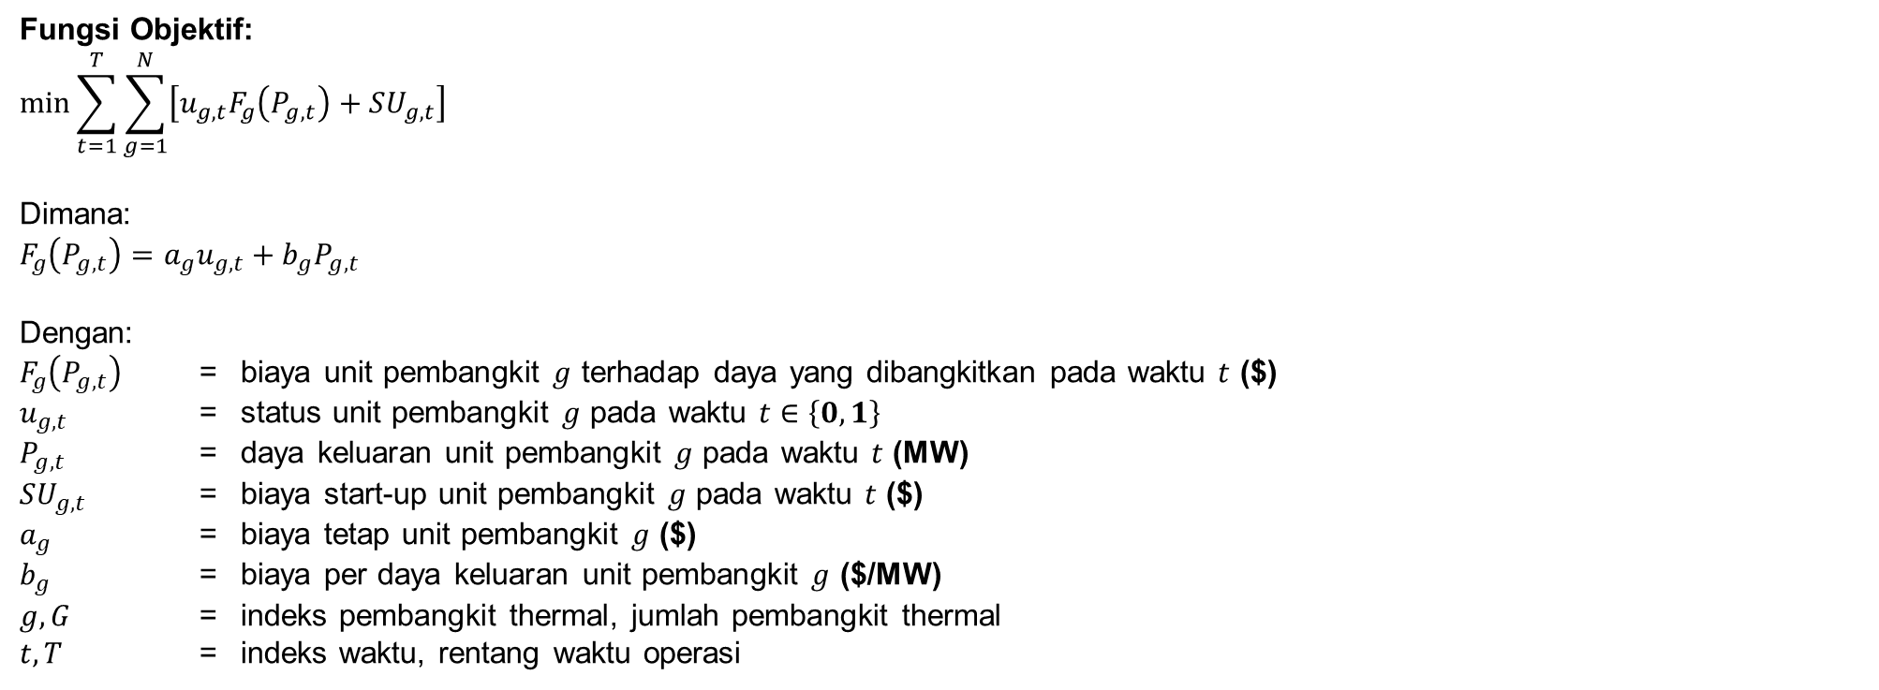
Fungsi Objektif (Minimum Total Cost)
Fungsi Objektif:
$$\min{\sum_{t=1}^{T}{\sum_{g=1}^{N}{\left[u_{g,t}F_{g}\left(P_{g,t}\right)+SU_{g,t}\right]}}}$$
Dimana:
$$F_{g}\left(P_{g,t}\right)=a_{g}u_{g,t}+b_{g}P_{g,t}$$
Dengan:
$F_{g}\left(P_{g,t}\right)$ = biaya unit pembangkit $g$ terhadap daya yang dibangkitkan pada waktu $t$ ($)
$u_{g,t}$ = status unit pembangkit $g$ pada waktu $t$ $∈\left\{0,1\right\}$
$P_{g,t}$ = daya keluaran unit pembangkit $g$ pada waktu $t$ (MW)
$SU_{g,t}$ = biaya start-up unit pembangkit $g$ pada waktu $t$ ($)
$a_{g}$ = biaya tetap unit pembangkit $g$ ($)
$b_{g}$ = biaya per daya keluaran unit pembangkit $g$ ($/MW)
$g, G$ = indeks pembangkit thermal, jumlah pembangkit thermal
$t,T$ = indeks waktu, rentang waktu operasi

Slide 3
Constraint
Constraint | Fungsi dalam Simulasi | Simulasi ke (#)
 |  | 1 | 2 | 3 | 4 | 5 | 6 | 7
use_initial_condition | Menetapkan kondisi awal sistem (status ON/OFF, output daya, dan riwayat operasi unit) sebagai titik awal optimasi | V | V | V | V | V | V | V
con_startup_shutdown_logic | Menentukan hubungan status ON/OFF dengan proses startup dan shutdown | V | V | V | V | V | V | V
con_power_balance | Menjamin total daya pembangkit memenuhi kebutuhan beban setiap interval waktu | V | V | V | V | V | V | V
con_capacity_upper | Membatasi output generator tidak melebihi kapasitas maksimum | V | V | V | V | V | V | V
con_capacity_lower | Menjamin generator yang beroperasi memenuhi batas minimum teknis | V | V | V | V | V | V | V
con_minimum_up_time | Mencegah generator dimatikan sebelum memenuhi waktu operasi minimum | V | V | V | V | V | V | V
con_minimum_down_time | Mencegah generator dinyalakan kembali sebelum memenuhi waktu padam minimum | V | V | V | V | V | V | V
con_ramp_up | Membatasi kenaikan output generator antar interval waktu | V | V | V | V | V | V | V
con_ramp_down | Membatasi penurunan output generator antar interval waktu | V | V | V | V | V | V | V
con_n1_spinning_reserve | Menjamin reserve cukup untuk mengantisipasi kehilangan pembangkit terbesar | V | V | V | V | V | V | V
con_battery | Membatasi operasi charge-discharge dan State of Charge (SOC) baterai |  | V | V |  | V | V | V
con_wt | Membatasi operasi ketersediaan, penggunaan dan curtailment PLTB. |  |  | V |  |  | V | V
con_min_inertia | Membatasi minimum inersia system berdasarkan Batasan RoCoF |  |  |  | V | V | V | V
con_battery_vi | Menambahkan kontribusi virtual inersia dari baterai |  |  |  |  |  |  | V
con_wt_vi | Menambahkan kontribusi virtual inersia dari PLTB |  |  |  |  |  |  | V

Slide 4
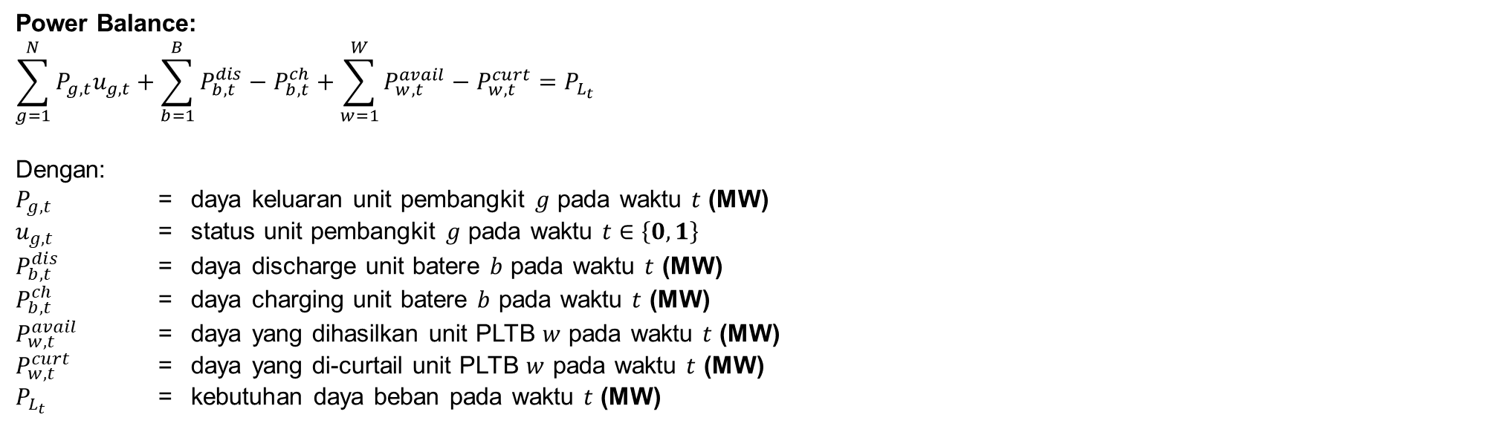
Formulasi Constraint (1)
Power Balance:
$$\sum_{g=1}^{N}{P_{g,t}u_{g,t}}+\sum_{b=1}^{B}{P_{b,t}^{dis}−P_{b,t}^{ch}}+\sum_{w=1}^{W}{P_{w,t}^{avail}−P_{w,t}^{curt}}=P_{L_{t}}$$
Dengan:
$P_{g,t}$ = daya keluaran unit pembangkit $g$ pada waktu $t$ (MW)
$u_{g,t}$ = status unit pembangkit $g$ pada waktu $t$ $∈\left\{0,1\right\}$
$P_{b,t}^{dis}$ = daya discharge unit batere $b$ pada waktu $t$ (MW)
$P_{b,t}^{ch}$ = daya charging unit batere $b$ pada waktu $t$ (MW)
$P_{w,t}^{avail}$ = daya yang dihasilkan unit PLTB $w$ pada waktu $t$ (MW)
$P_{w,t}^{curt}$ = daya yang di-curtail unit PLTB $w$ pada waktu $t$ (MW)
$P_{L_{t}}$ = kebutuhan daya beban pada waktu $t$ (MW)

Slide 5
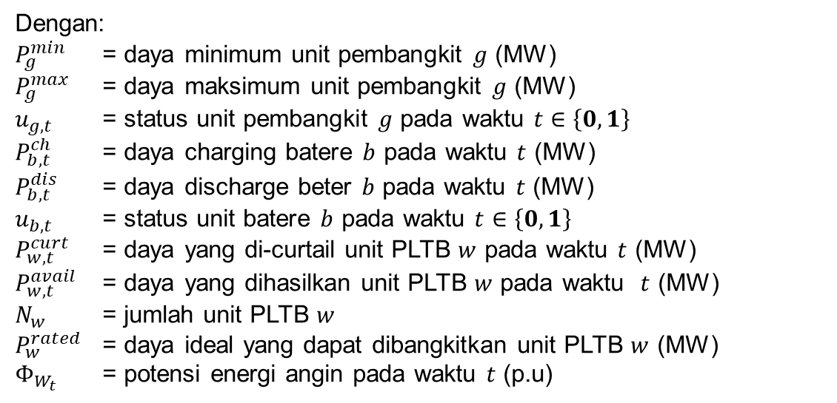
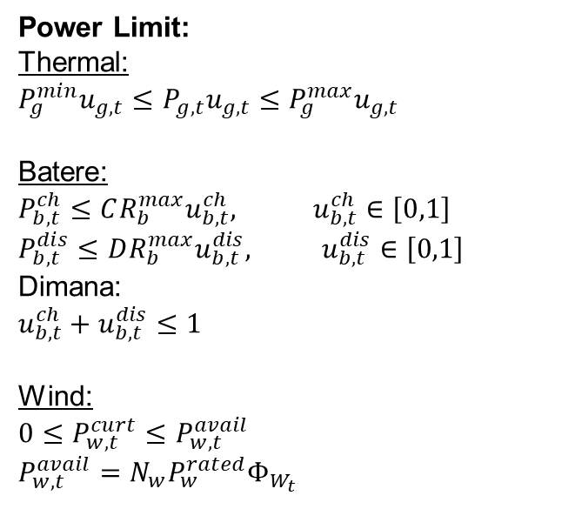
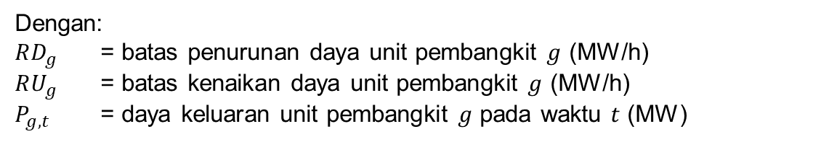

Formulasi Constraint (2)
Power Limit:
Thermal:
$$P_{g}^{min}u_{g,t}≤P_{g,t}u_{g,t}≤P_{g}^{max}u_{g,t}$$
Batere:
$$P_{b,t}^{ch}≤{CR_{b}^{max}u}_{b,t}^{ch}, u_{b,t}^{ch}∈\left[0,1\right]$$
$$P_{b,t}^{dis}≤DR_{b}^{max}u_{b,t}^{dis}, u_{b,t}^{dis}∈\left[0,1\right]$$
Dimana:
$$u_{b,t}^{ch}+u_{b,t}^{dis}≤1$$
Wind:
$$0≤P_{w,t}^{curt}≤P_{w,t}^{avail}$$
$$P_{w,t}^{avail}=N_{w}P_{w}^{rated}Φ_{W_{t}}$$
Dengan:
$P_{g}^{min}$ = daya minimum unit pembangkit $g$ (MW)
$P_{g}^{max}$ = daya maksimum unit pembangkit $g$ (MW)
$u_{g,t}$ = status unit pembangkit $g$ pada waktu $t$ $∈\left\{0,1\right\}$
$P_{b,t}^{ch}$ = daya charging batere $b$ pada waktu $t$ (MW)
$P_{b,t}^{dis}$ = daya discharge beter $b$ pada waktu $t$ (MW)
$u_{b,t}$ = status unit batere $b$ pada waktu $t$ $∈\left\{0,1\right\}$
$P_{w,t}^{curt}$ = daya yang di-curtail unit PLTB $w$ pada waktu $t$ (MW)
$P_{w,t}^{avail}$ = daya yang dihasilkan unit PLTB $w$ pada waktu $t$ (MW)
$N_{w}$ = jumlah unit PLTB $w$
$P_{w}^{rated}$ = daya ideal yang dapat dibangkitkan unit PLTB $w$ (MW)
$Φ_{W_{t}}$ = potensi energi angin pada waktu $t$ (p.u)
Ramp Up/Down:
$$−RD_{g}≤P_{g,t}−P_{g,t−1}≤RU_{g}$$
Dengan:
$RD_{g}$ = batas penurunan daya unit pembangkit $g$ (MW/h)
$RU_{g}$ = batas kenaikan daya unit pembangkit $g$ (MW/h)
$P_{g,t}$ = daya keluaran unit pembangkit $g$ pada waktu $t$ (MW)

Slide 6
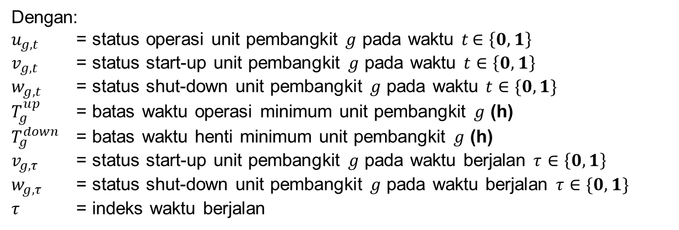
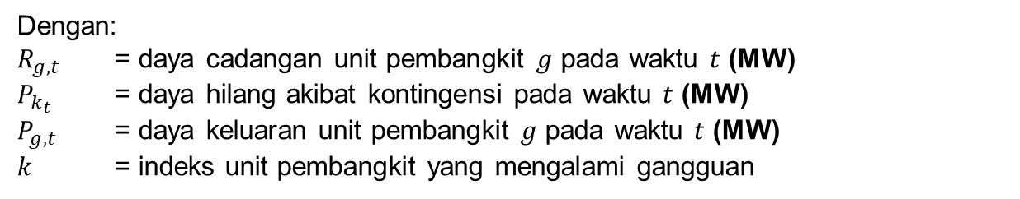
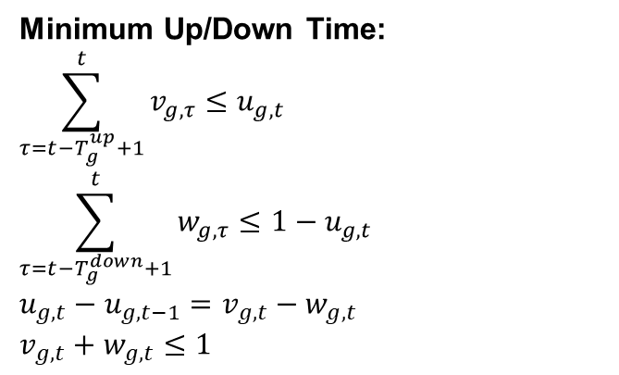
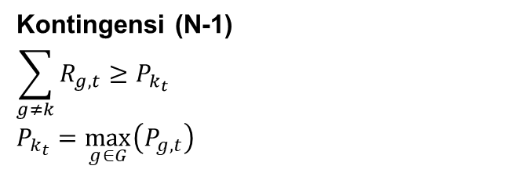
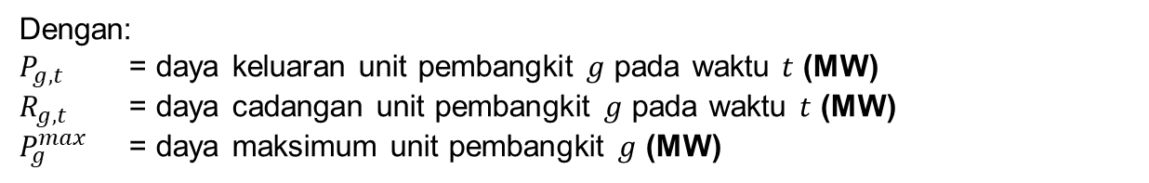
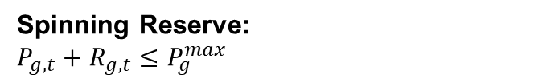
Formulasi Constraint (3)
Minimum Up/Down Time:
$$\sum_{τ=t−T_{g}^{up}+1}^{t}{v_{g,τ}}≤u_{g,t}$$
$$\sum_{τ=t−T_{g}^{down}+1}^{t}{w_{g,τ}}≤1−u_{g,t}$$
$$u_{g,t}−u_{g,t−1}=v_{g,t}−w_{g,t}$$
$$v_{g,t}+w_{g,t}≤1$$
Dengan:
$u_{g,t}$ = status operasi unit pembangkit $g$ pada waktu $t$ $∈\left\{0,1\right\}$
$v_{g,t}$ = status start-up unit pembangkit $g$ pada waktu $t$ $∈\left\{0,1\right\}$
$w_{g,t}$ = status shut-down unit pembangkit $g$ pada waktu $t$ $∈\{0,1\}$
$T_{g}^{up}$ = batas waktu operasi minimum unit pembangkit $g$ (h)
$T_{g}^{down}$ = batas waktu henti minimum unit pembangkit $g$ (h)
$v_{g,τ}$ = status start-up unit pembangkit $g$ pada waktu berjalan $τ$ $∈\left\{0,1\right\}$
$w_{g,τ}$ = status shut-down unit pembangkit $g$ pada waktu berjalan $τ$ $∈\{0,1\}$
$τ$ = indeks waktu berjalan
Spinning Reserve:
$$P_{g,t}+R_{g,t}≤P_{g}^{max}$$
Dengan:
$P_{g,t}$ = daya keluaran unit pembangkit $g$ pada waktu $t$ (MW)
$R_{g,t}$ = daya cadangan unit pembangkit $g$ pada waktu $t$ (MW)
$P_{g}^{max}$ = daya maksimum unit pembangkit $g$ (MW)
Kontingensi (N-1)
$$\sum_{g≠k}{R_{g,t}}≥P_{k_{t}}$$
$$P_{k_{t}}=\max_{g∈G}\left(P_{g,t}\right)$$
Dengan:
$R_{g,t}$ = daya cadangan unit pembangkit $g$ pada waktu $t$ (MW)
$P_{k_{t}}$ = daya hilang akibat kontingensi pada waktu $t$ (MW)
$P_{g,t}$ = daya keluaran unit pembangkit $g$ pada waktu $t$ (MW)
$k$ = indeks unit pembangkit yang mengalami gangguan

Slide 7
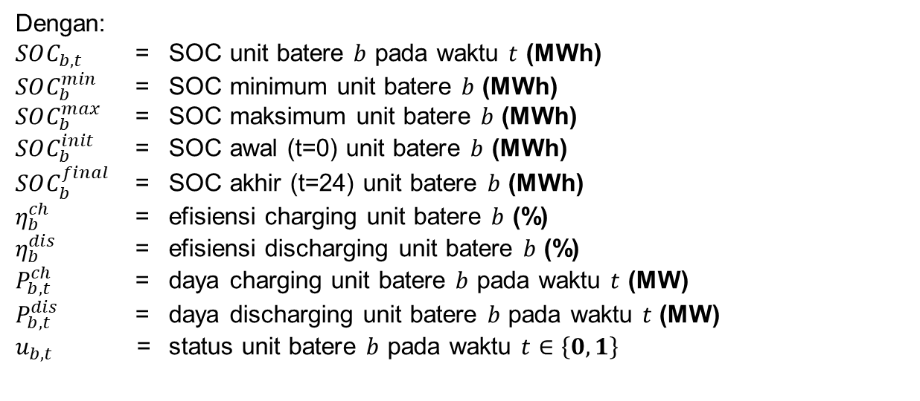
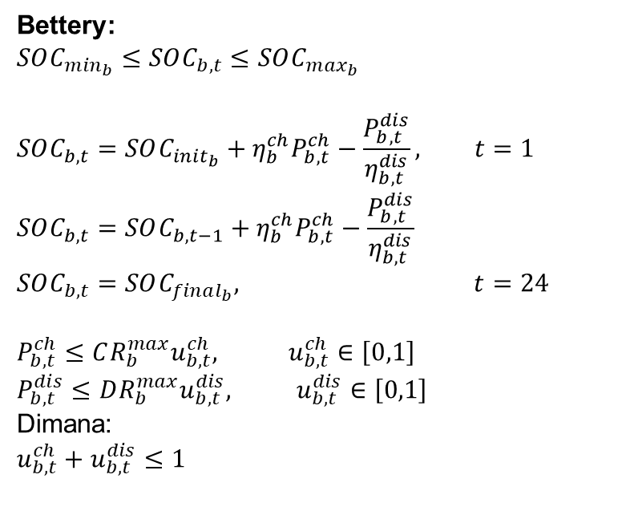
Formulasi Constraint (4)
Bettery:
$$SOC_{m{in}_{b}}≤SOC_{b,t}≤SOC_{m{ax}_{b}}$$
$$SOC_{b,t}=SOC_{init_{b}}+η_{b}^{ch}P_{b,t}^{ch}−\frac{P_{b,t}^{dis}}{η_{b,t}^{dis}}, t=1$$
$$SOC_{b,t}=SOC_{b,t−1}+η_{b}^{ch}P_{b,t}^{ch}−\frac{P_{b,t}^{dis}}{η_{b,t}^{dis}}$$
$$SOC_{b,t}=SOC_{final_{b}}, t=24$$
$$P_{b,t}^{ch}≤{CR_{b}^{max}u}_{b,t}^{ch}, u_{b,t}^{ch}∈\left[0,1\right]$$
$$P_{b,t}^{dis}≤DR_{b}^{max}u_{b,t}^{dis}, u_{b,t}^{dis}∈\left[0,1\right]$$
Dimana:
$$u_{b,t}^{ch}+u_{b,t}^{dis}≤1$$
Dengan:
$SOC_{b,t}$ = SOC unit batere $b$ pada waktu $t$ (MWh)
$SOC_{b}^{min}$ = SOC minimum unit batere $b$ (MWh)
$SOC_{b}^{max}$ = SOC maksimum unit batere $b$ (MWh)
$SOC_{b}^{init}$ = SOC awal (t=0) unit batere $b$ (MWh)
$SOC_{b}^{final}$ = SOC akhir (t=24) unit batere $b$ (MWh)
$η_{b}^{ch}$ = efisiensi charging unit batere $b$ (%)
$η_{b}^{dis}$ = efisiensi discharging unit batere $b$ (%)
$P_{b,t}^{ch}$ = daya charging unit batere $b$ pada waktu $t$ (MW)
$P_{b,t}^{dis}$ = daya discharging unit batere $b$ pada waktu $t$ (MW)
$u_{b,t}$ = status unit batere $b$ pada waktu $t$ $∈\left\{0,1\right\}$

Slide 8
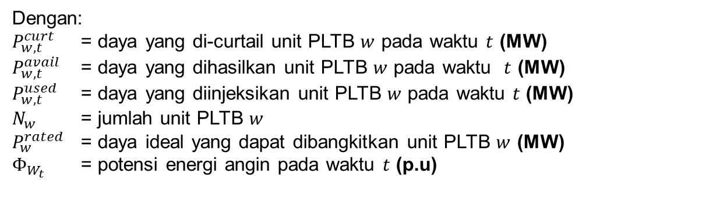

Formulasi Constraint (5)
Wind Turbine:
$$0≤P_{w,t}^{curt}≤P_{w,t}^{avail}$$
$$P_{w,t}^{avail}=N_{w}P_{w}^{rated}Φ_{W_{t}}$$
$$P_{w,t}^{used}=P_{w,t}^{avail}−P_{w,t}^{curt}$$
Dengan:
$P_{w,t}^{curt}$ = daya yang di-curtail unit PLTB $w$ pada waktu $t$ (MW)
$P_{w,t}^{avail}$ = daya yang dihasilkan unit PLTB $w$ pada waktu $t$ (MW)
$P_{w,t}^{used}$ = daya yang diinjeksikan unit PLTB $w$ pada waktu $t$ (MW)
$N_{w}$ = jumlah unit PLTB $w$
$P_{w}^{rated}$ = daya ideal yang dapat dibangkitkan unit PLTB $w$ (MW)
$Φ_{W_{t}}$ = potensi energi angin pada waktu $t$ (p.u)

Slide 9
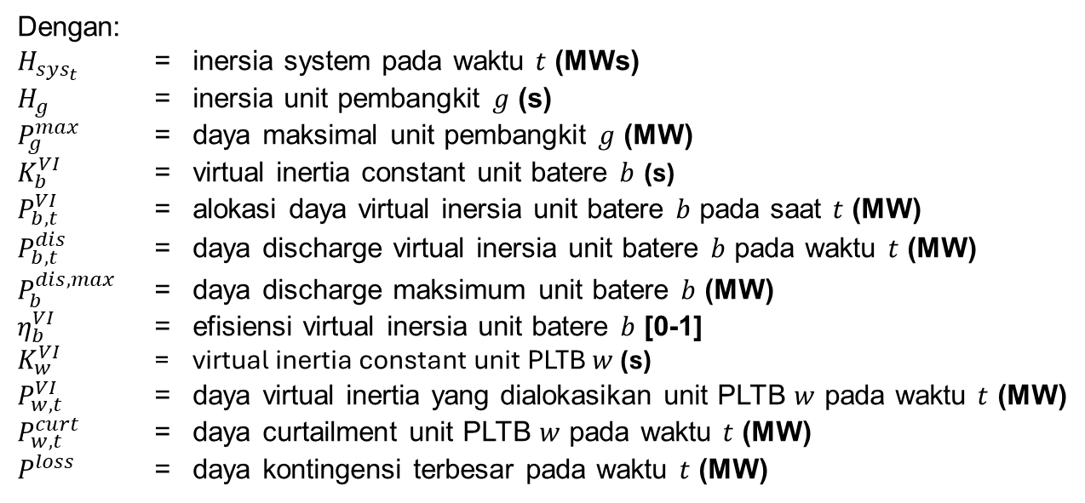
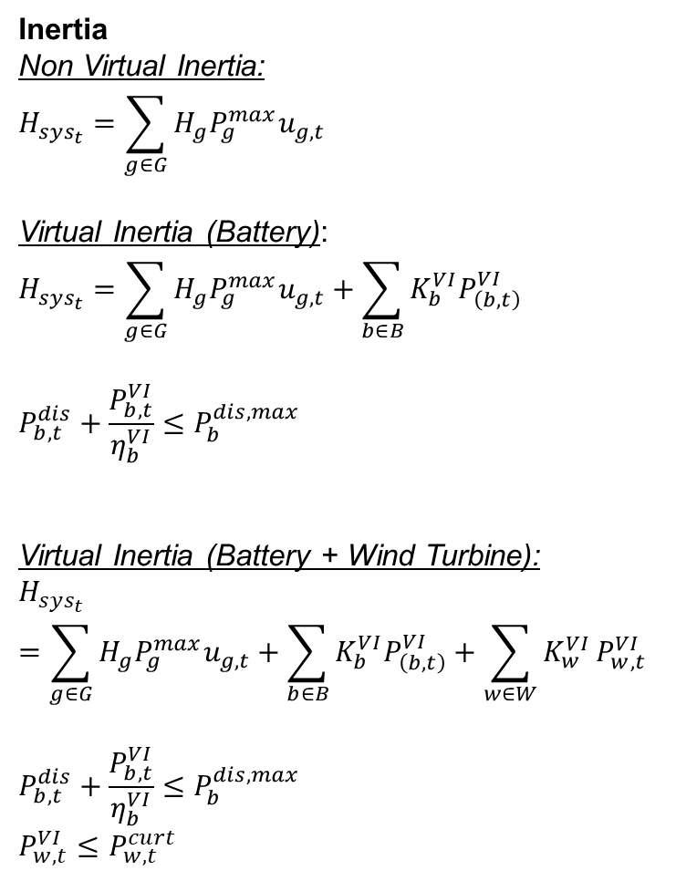
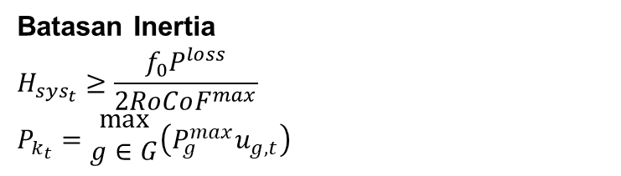
Formulasi Constraint (6)
Inertia
Non Virtual Inertia:
$$H_{sys_{t}}=\sum_{g∈G}{H_{g}P_{g}^{max}u_{g,t}}$$
Virtual Inertia (Battery):
$$H_{sys_{t}}=\sum_{g∈G}{H_{g}P_{g}^{max}u_{g,t}}+\sum_{b∈B}{K_{b}^{VI}P_{\left(b,t\right)}^{VI}}$$
$$P_{b,t}^{dis}+\frac{P_{b,t}^{VI}}{η_{b}^{VI}}≤P_{b}^{dis,max}$$
Virtual Inertia (Battery + Wind Turbine):
$$H_{sys_{t}}=\sum_{g∈G}{H_{g}P_{g}^{max}u_{g,t}}+\sum_{b∈B}{K_{b}^{VI}P_{\left(b,t\right)}^{VI}}+\sum_{w∈W}{K_{w}^{VI}}P_{w,t}^{VI}$$
$$P_{b,t}^{dis}+\frac{P_{b,t}^{VI}}{η_{b}^{VI}}≤P_{b}^{dis,max}$$
$$P_{w,t}^{VI}≤P_{w,t}^{curt}$$
Dengan:
$H_{sys_{t}}$ = inersia system pada waktu $t$ (MWs)
$H_{g}$ = inersia unit pembangkit $g$ (s)
$P_{g}^{max}$ = daya maksimal unit pembangkit $g$ (MW)
$K_{b}^{VI}$ = virtual inertia constant unit batere $b$ (s)
$P_{b,t}^{VI}$ = alokasi daya virtual inersia unit batere $b$ pada saat $t$ (MW)
$P_{b,t}^{dis}$ = daya discharge virtual inersia unit batere $b$ pada waktu $t$ (MW)
$P_{b}^{dis,max}$ = daya discharge maksimum unit batere $b$ (MW)
$η_{b}^{VI}$ = efisiensi virtual inersia unit batere $b$ [0-1]
$K_{w}^{VI}$ = virtual inertia constant unit PLTB $w$ (s)
$P_{w,t}^{VI}$ = daya virtual inertia yang dialokasikan unit PLTB $w$ pada waktu $t$ (MW)
$P_{w,t}^{curt}$ = daya curtailment unit PLTB $w$ pada waktu $t$ (MW)
$P^{loss}$ = daya kontingensi terbesar pada waktu $t$ (MW)
Batasan Inertia
$$H_{sys_{t}}≥\frac{f_{0}P^{loss}}{2RoCoF^{max}}$$
$$P_{k_{t}}=\begin{aligned}max \\ g∈G\end{aligned}\left(P_{g}^{max}u_{g,t}\right)$$

Slide 10
Input Data
Frequency Nominal = 50 Hz | RoCoF = 0,55 Hz/s
# | Type | Pmin (MW) | Pmax (MW) | b ($/MW) | c ($/h) | SUC ($) | Ramp (MW/h) | MUT (h) | MDT (h) | Initial Power (MW)
G1 | PLTU 1 | 627 | 1176 | 26.1 | 3594.9 | 58800 | 120 | 23 | 23 | 1176
G2 | PLTGU 1 | 340 | 1125 | 51.3 | 3825.1 | 90000 | 300 | 2 | 12 | 340
G3 | PLTU 2 | 600 | 969 | 26.1 | 3440.1 | 48450 | 120 | 23 | 23 | 600
G4 | PLTG 1 | 85 | 130 | 89.1 | 1662.9 | 3120 | 480 | 12 | 10 | 85
G5 | PLTG 2 | 66 | 108 | 89.1 | 1291.2 | 2592 | 480 | 2 | 2 | 66
G6 | PLTGU 2 | 250 | 1095 | 51.3 | 2812.5 | 87600 | 300 | 2 | 2 | 250
G7 | PLTGU 3 | 248 | 810 | 51.3 | 2790.0 | 64800 | 300 | 23 | 23 | 248
G8 | PLTGU 4 | 347.85 | 773 | 51.3 | 3913.4 | 61840 | 300 | 1 | 2 | 347.85
G9 | PLTU 3 | 540 | 870 | 26.1 | 3096.0 | 43500 | 120 | 1 | 3 | 540
G10 | PLTU 4 | 600 | 840 | 26.1 | 3440.1 | 42000 | 120 | 23 | 23 | 600
# | Type | Inersia (s) | Governor Ramp (MW/s) | Frequency Dead Band (Hz)
G1 | PLTU 1 | 4 | 129.8 | 0
G2 | PLTGU 1 | 9 | 31.654 | 0
G3 | PLTU 2 | 4 | 85.55 | 0
G4 | PLTG 1 | 6 | 31.948 | 0
G5 | PLTG 2 | 6 | 24.892 | 0
G6 | PLTGU 2 | 9 | 33.663 | 0
G7 | PLTGU 3 | 9 | 28.42 | 0
G8 | PLTGU 4 | 9 | 27.636 | 0
G9 | PLTU 3 | 4 | 102.07 | 0
G10 | PLTU 4 | 4 | 122.72 | 0
# | SOC Min (MW) | SOC Max (MW) | Charge Rate Max (MW) | Discharge Rate Max (MW) | Charge Efficiency | Discharge Efficiency | Initial SOC | Final SOC
B1 | 10 | 155 | 60 | 60 | 100% | 100% | 15,5 | 15,5
B2 | 10 | 50 | 20 | 20 | 100% | 100% | 25 | 25
WT Capacity = 400 MW
H batt = 5 MWs (virtual)
H wind = 4 MWs (virtual)

Slide 11
Total Cost
Cost | #1 | #2 | #3 | #4 | #5 | #6 | #7
Fuel Cost | 3452429.39 | 3506627.97 | 3226209.51 | 3625928.24 | 3620476.72 | 3388276.88 | 3383101.16
Fixed Cost | 514953.96 | 507544.58 | 487589.54 | 555881.46 | 555881.46 | 555881.46 | 555881.46
Startup Cost | 61840.00 | 5712.00 | 2592.00 | 0.00 | 0.00 | 0.00 | 0.00
Total Cost | 4029223.23 | 4019884.52 | 3716390.94 | 4181809.71 | 4176358.21 | 3944158.37 | 3938982.65
*urutan simulasi mengacu pada slide constraint

Slide 12
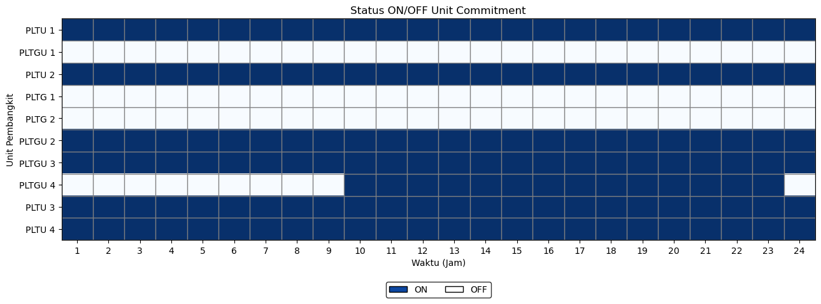
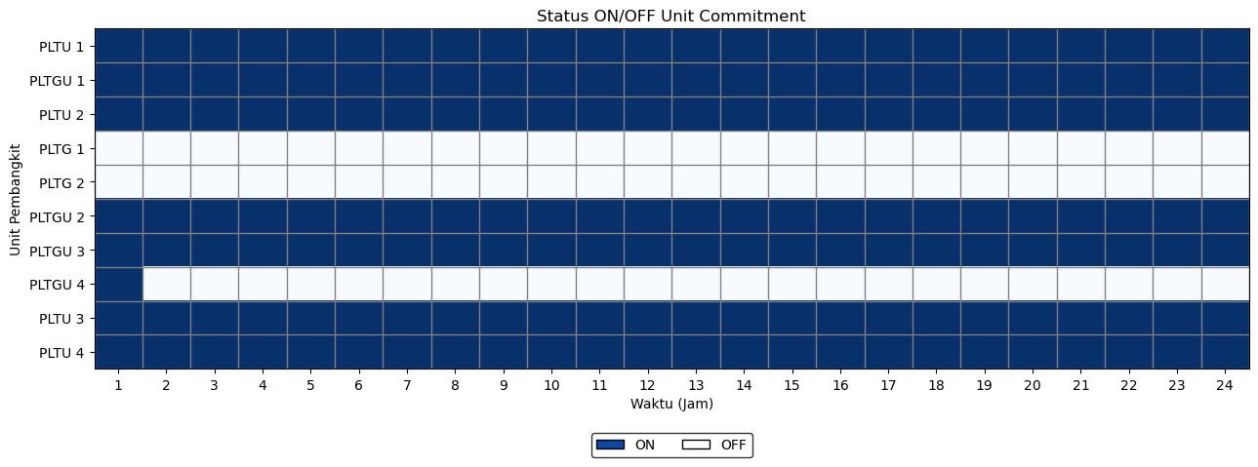
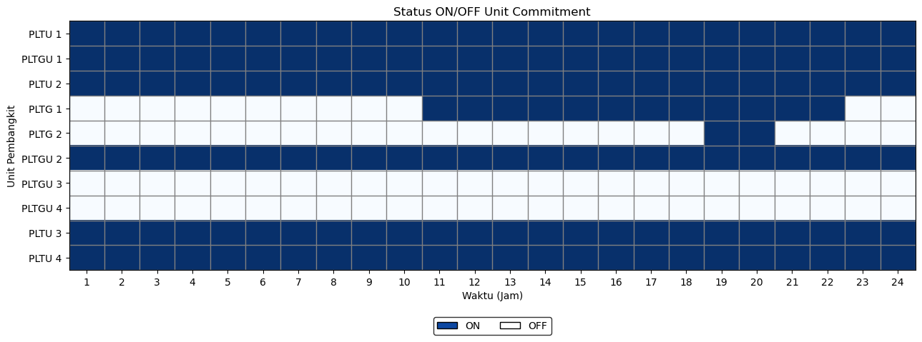
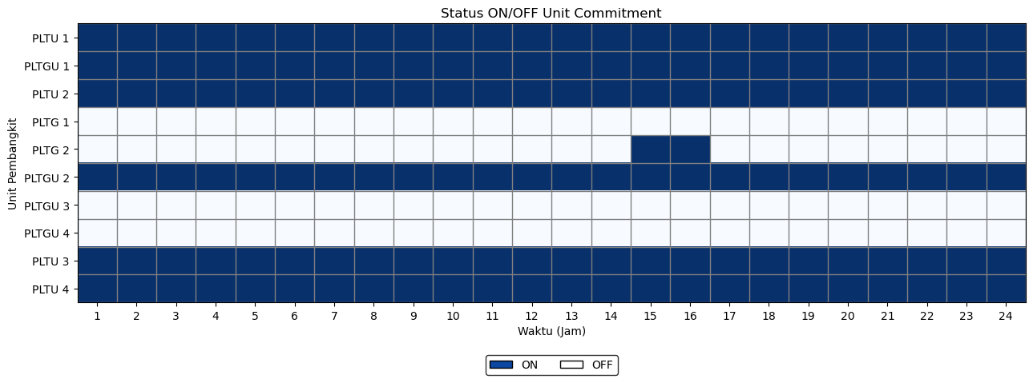
Status Unit (1)
#1
#4
#2
#5
#3
#6

Slide 13
Status Unit (2)
#7

Slide 14
Dispatch (1)
#1
Gen |  | Hour
 |  | 1 | 2 | 3 | 4 | 5 | 6 | 7 | 8 | 9 | 10 | 11 | 12 | 13 | 14 | 15 | 16 | 17 | 18 | 19 | 20 | 21 | 22 | 23 | 24
G 01 | PLTU 1 | 1176 | 1176 | 1176 | 1176 | 1176 | 1176 | 1176 | 1167.69 | 1176 | 1176 | 1176 | 1176 | 1176 | 1176 | 1176 | 1176 | 1176 | 1176 | 1176 | 1176 | 1176 | 1176 | 1176 | 1176
G 02 | PLTGU 1 | 0 | 0 | 0 | 0 | 0 | 0 | 0 | 0 | 0 | 0 | 0 | 0 | 0 | 0 | 0 | 0 | 0 | 0 | 0 | 0 | 0 | 0 | 0 | 0
G 03 | PLTU 2 | 720 | 840 | 915.2 | 827.52 | 707.52 | 827.52 | 889.06 | 849 | 969 | 969 | 969 | 969 | 969 | 969 | 969 | 969 | 969 | 969 | 969 | 969 | 969 | 969 | 969 | 969
G 04 | PLTG 1 | 0 | 0 | 0 | 0 | 0 | 0 | 0 | 0 | 0 | 0 | 0 | 0 | 0 | 0 | 0 | 0 | 0 | 0 | 0 | 0 | 0 | 0 | 0 | 0
G 05 | PLTG 2 | 0 | 0 | 0 | 0 | 0 | 0 | 0 | 0 | 0 | 0 | 0 | 0 | 0 | 0 | 0 | 0 | 0 | 0 | 0 | 0 | 0 | 0 | 0 | 0
G 06 | PLTGU 2 | 550 | 289.17 | 250 | 250 | 250 | 250 | 250 | 250 | 250 | 396.22 | 250 | 250 | 299.47 | 250 | 250 | 250 | 250 | 250 | 250 | 250 | 250 | 250 | 250 | 393.26
G 07 | PLTGU 3 | 399.68 | 248 | 248 | 248 | 248 | 248 | 248 | 248 | 426.45 | 248 | 496.87 | 248 | 248 | 248 | 548 | 609.74 | 547.6 | 447.71 | 248 | 548 | 248 | 441.61 | 250.67 | 248
G 08 | PLTGU 4 | 0 | 0 | 0 | 0 | 0 | 0 | 0 | 0 | 0 | 347.85 | 379.12 | 679.12 | 379.12 | 602.81 | 454.43 | 347.85 | 347.85 | 347.85 | 599.27 | 479.4 | 727.68 | 427.68 | 347.85 | 0
G 09 | PLTU 3 | 660 | 780 | 660 | 667.86 | 787.86 | 870 | 870 | 870 | 870 | 870 | 870 | 870 | 870 | 870 | 870 | 870 | 870 | 870 | 870 | 870 | 870 | 870 | 870 | 870
G 10 | PLTU 4 | 720 | 840 | 840 | 840 | 840 | 840 | 840 | 840 | 840 | 840 | 840 | 840 | 840 | 840 | 840 | 840 | 840 | 840 | 840 | 840 | 840 | 840 | 840 | 840
B 01 | Battery 1 | 0 | 0 | 0 | 0 | 0 | 0 | 0 | 0 | 0 | 0 | 0 | 0 | 0 | 0 | 0 | 0 | 0 | 0 | 0 | 0 | 0 | 0 | 0 | 0
B 02 | Battery 2 | 0 | 0 | 0 | 0 | 0 | 0 | 0 | 0 | 0 | 0 | 0 | 0 | 0 | 0 | 0 | 0 | 0 | 0 | 0 | 0 | 0 | 0 | 0 | 0
WT | Wind | 0 | 0 | 0 | 0 | 0 | 0 | 0 | 0 | 0 | 0 | 0 | 0 | 0 | 0 | 0 | 0 | 0 | 0 | 0 | 0 | 0 | 0 | 0 | 0
#2
Gen |  | Hour
 |  | 1 | 2 | 3 | 4 | 5 | 6 | 7 | 8 | 9 | 10 | 11 | 12 | 13 | 14 | 15 | 16 | 17 | 18 | 19 | 20 | 21 | 22 | 23 | 24
G 01 | PLTU 1 | 1176 | 1176 | 1176 | 1176 | 1176 | 1176 | 1176 | 1155.69 | 1176 | 1176 | 1176 | 1176 | 1176 | 1176 | 1176 | 1176 | 1176 | 1176 | 1176 | 1176 | 1176 | 1176 | 1176 | 1176
G 02 | PLTGU 1 | 379.18 | 340 | 340 | 340 | 340 | 340 | 340 | 340 | 422.07 | 722.07 | 470.98 | 765.81 | 465.81 | 765.81 | 537.43 | 340 | 340 | 340 | 479.87 | 340 | 602.6 | 484.3 | 536.96 | 340
G 03 | PLTU 2 | 720 | 840 | 876.03 | 969 | 863.38 | 969 | 969 | 969 | 969 | 969 | 969 | 969 | 969 | 969 | 969 | 969 | 969 | 969 | 969 | 969 | 969 | 969 | 969 | 969
G 04 | PLTG 1 | 0 | 0 | 0 | 0 | 0 | 0 | 0 | 0 | 0 | 0 | 85 | 85 | 85 | 85 | 85 | 85 | 85 | 85 | 85 | 85 | 85 | 85 | 0 | 0
G 05 | PLTG 2 | 0 | 0 | 0 | 0 | 0 | 0 | 0 | 0 | 0 | 0 | 0 | 0 | 0 | 0 | 0 | 0 | 0 | 0 | 66 | 66 | 0 | 0 | 0 | 0
G 06 | PLTGU 2 | 550 | 250 | 250 | 250 | 250 | 250 | 250 | 250 | 254.38 | 250 | 550 | 286.3 | 455.77 | 250 | 550 | 749 | 734.04 | 700.56 | 486.4 | 786.4 | 486.4 | 550 | 250 | 250
G 07 | PLTGU 3 | 0 | 0 | 0 | 0 | 0 | 0 | 0 | 0 | 0 | 0 | 0 | 0 | 0 | 0 | 0 | 0 | 0 | 0 | 0 | 0 | 0 | 0 | 0 | 0
G 08 | PLTGU 4 | 0 | 0 | 0 | 0 | 0 | 0 | 0 | 0 | 0 | 0 | 0 | 0 | 0 | 0 | 0 | 0 | 0 | 0 | 0 | 0 | 0 | 0 | 0 | 0
G 09 | PLTU 3 | 660 | 727.17 | 607.17 | 540 | 540 | 636.52 | 756.52 | 870 | 870 | 870 | 870 | 870 | 870 | 870 | 870 | 870 | 870 | 870 | 870 | 870 | 870 | 870 | 870 | 870
G 10 | PLTU 4 | 720 | 840 | 840 | 780.92 | 840 | 840 | 840 | 720 | 840 | 840 | 840 | 840 | 840 | 840 | 840 | 840 | 840 | 840 | 840 | 840 | 840 | 840 | 840 | 840
B 01 | Battery 1 | 5.50 | 0.00 | 0.00 | -26.54 | 0.00 | 0.00 | -58.46 | -60.00 | 0.00 | 0.00 | 0.00 | 60.00 | -60.00 | 0.00 | 60.00 | 13.59 | -13.59 | -60.00 | 0.00 | 0.00 | 51.68 | 0.00 | 56.56 | 31.26
B 02 | Battery 2 | 15.00 | 0.00 | 0.00 | -20.00 | 0.00 | 0.00 | 0.00 | -20.00 | 0.00 | 20.00 | 20.00 | -20.00 | -20.00 | 0.00 | 20.00 | 20.00 | 0.00 | -20.00 | -20.00 | 0.00 | 0.00 | 0.00 | 5.00 | 20.00
WT | Wind | 0.00 | 0.00 | 0.00 | 0.00 | 0.00 | 0.00 | 0.00 | 0.00 | 0.00 | 0.00 | 0.00 | 0.00 | 0.00 | 0.00 | 0.00 | 0.00 | 0.00 | 0.00 | 0.00 | 0.00 | 0.00 | 0.00 | 0.00 | 0.00
#3
Gen |  | Hour
 |  | 1 | 2 | 3 | 4 | 5 | 6 | 7 | 8 | 9 | 10 | 11 | 12 | 13 | 14 | 15 | 16 | 17 | 18 | 19 | 20 | 21 | 22 | 23 | 24
G 01 | PLTU 1 | 1176 | 1176 | 1176 | 1176 | 1176 | 1159.14 | 1054.89 | 1038.36 | 1158.36 | 1176 | 1176 | 1176 | 1176 | 1176 | 1176 | 1176 | 1176 | 1176 | 1176 | 1176 | 1176 | 1176 | 1176 | 1176
G 02 | PLTGU 1 | 340 | 340 | 340 | 340 | 340 | 340 | 340 | 340 | 340 | 351.09 | 527.32 | 726.55 | 638.04 | 656.78 | 449.34 | 640 | 340 | 528.27 | 613.57 | 716.02 | 660.19 | 591.93 | 379.05 | 340
G 03 | PLTU 2 | 659.18 | 600 | 715.77 | 703.18 | 600 | 600 | 609 | 729 | 849 | 969 | 969 | 969 | 969 | 969 | 969 | 969 | 969 | 969 | 969 | 969 | 969 | 969 | 969 | 969
G 04 | PLTG 1 | 0 | 0 | 0 | 0 | 0 | 0 | 0 | 0 | 0 | 0 | 0 | 0 | 0 | 0 | 0 | 0 | 0 | 0 | 0 | 0 | 0 | 0 | 0 | 0
G 05 | PLTG 2 | 0 | 0 | 0 | 0 | 0 | 0 | 0 | 0 | 0 | 0 | 0 | 0 | 0 | 0 | 66 | 66 | 0 | 0 | 0 | 0 | 0 | 0 | 0 | 0
G 06 | PLTGU 2 | 250 | 250 | 250 | 250 | 250 | 250 | 250 | 250 | 250 | 250 | 250 | 250 | 250 | 250 | 550 | 380.27 | 680.05 | 380.05 | 250 | 250 | 250 | 250 | 250 | 250
G 07 | PLTGU 3 | 0 | 0 | 0 | 0 | 0 | 0 | 0 | 0 | 0 | 0 | 0 | 0 | 0 | 0 | 0 | 0 | 0 | 0 | 0 | 0 | 0 | 0 | 0 | 0
G 08 | PLTGU 4 | 0 | 0 | 0 | 0 | 0 | 0 | 0 | 0 | 0 | 0 | 0 | 0 | 0 | 0 | 0 | 0 | 0 | 0 | 0 | 0 | 0 | 0 | 0 | 0
G 09 | PLTU 3 | 660 | 628.66 | 540 | 631.63 | 751.63 | 870 | 870 | 870 | 785.5 | 870 | 870 | 870 | 870 | 870 | 870 | 870 | 870 | 870 | 870 | 870 | 870 | 870 | 870 | 870
G 10 | PLTU 4 | 720 | 840 | 720 | 600 | 600 | 720 | 840 | 840 | 840 | 840 | 840 | 840 | 840 | 840 | 840 | 840 | 840 | 840 | 840 | 840 | 840 | 840 | 840 | 771.45
B 01 | Battery 1 | 5.50 | 0.00 | 0.00 | -25.00 | -60.00 | 0.00 | 0.00 | -60.00 | 0.00 | 0.00 | 60.00 | 0.00 | -60.00 | 60.00 | 60.00 | 0.00 | -60.00 | -60.00 | 0.00 | 25.00 | 60.00 | 60.00 | 0.00 | -5.50
B 02 | Battery 2 | 15.00 | 0.00 | 0.00 | 0.00 | -20.00 | 0.00 | 0.00 | -20.00 | 0.00 | 0.00 | 0.00 | 20.00 | -20.00 | 0.00 | 0.00 | 20.00 | 0.00 | -20.00 | 0.00 | 20.00 | 0.00 | 20.00 | 0.00 | -15.00
WT | Wind | 400 | 338.51 | 347.43 | 333.57 | 371.75 | 272.38 | 309.17 | 237.33 | 308.59 | 390.99 | 288.67 | 180.56 | 118.54 | 134.03 | 127.09 | 101.32 | 185.4 | 217.23 | 233.7 | 266.38 | 255.5 | 197.37 | 219.46 | 140.31

Slide 15
Dispatch (2)
#4
Gen |  | Hour
 |  | 1 | 2 | 3 | 4 | 5 | 6 | 7 | 8 | 9 | 10 | 11 | 12 | 13 | 14 | 15 | 16 | 17 | 18 | 19 | 20 | 21 | 22 | 23 | 24
G 01 | PLTU 1 | 1056 | 939.18 | 819.18 | 699.18 | 819.18 | 724.34 | 785.88 | 819.18 | 939.18 | 939.18 | 939.18 | 939.18 | 939.18 | 939.18 | 939.18 | 939.18 | 939.18 | 939.18 | 939.18 | 939.18 | 939.18 | 939.18 | 939.18 | 939.18
G 02 | PLTGU 1 | 340 | 340 | 340 | 340 | 340 | 340 | 340 | 340 | 445.09 | 340 | 340 | 395.22 | 695.22 | 395.22 | 340 | 340 | 340 | 340 | 340 | 340 | 340 | 340 | 340 | 409.9
G 03 | PLTU 2 | 720 | 840 | 819.18 | 939.18 | 819.18 | 939.18 | 939.18 | 939.18 | 939.18 | 939.18 | 939.18 | 939.18 | 939.18 | 939.18 | 939.18 | 939.18 | 939.18 | 939.18 | 939.18 | 939.18 | 939.18 | 939.18 | 939.18 | 939.18
G 04 | PLTG 1 | 0 | 0 | 0 | 0 | 0 | 0 | 0 | 0 | 0 | 0 | 0 | 0 | 0 | 0 | 0 | 0 | 0 | 0 | 0 | 0 | 0 | 0 | 0 | 0
G 05 | PLTG 2 | 0 | 0 | 0 | 0 | 0 | 0 | 0 | 0 | 0 | 0 | 0 | 0 | 0 | 0 | 0 | 0 | 0 | 0 | 0 | 0 | 0 | 0 | 0 | 0
G 06 | PLTGU 2 | 250 | 250 | 250 | 250 | 250 | 250 | 250 | 250 | 250 | 370.71 | 250 | 500.53 | 250 | 424.23 | 369.07 | 324.23 | 524.09 | 724.2 | 475.91 | 394.04 | 604.32 | 797.94 | 527.16 | 250
G 07 | PLTGU 3 | 248 | 300.16 | 248 | 248 | 248 | 248 | 248 | 248 | 248 | 548 | 802.62 | 548 | 248 | 548 | 810 | 810 | 548 | 248 | 548 | 810 | 548 | 248 | 248 | 248
G 08 | PLTGU 4 | 347.85 | 0 | 0 | 0 | 0 | 0 | 0 | 0 | 0 | 0 | 0 | 0 | 0 | 0 | 0 | 0 | 0 | 0 | 0 | 0 | 0 | 0 | 0 | 0
G 09 | PLTU 3 | 543.83 | 663.83 | 772.84 | 693.02 | 813.02 | 870 | 870 | 788.33 | 870 | 870 | 870 | 870 | 870 | 870 | 870 | 870 | 870 | 870 | 870 | 870 | 870 | 870 | 870 | 870
G 10 | PLTU 4 | 720 | 840 | 840 | 840 | 720 | 840 | 840 | 840 | 840 | 840 | 840 | 840 | 840 | 840 | 840 | 840 | 840 | 840 | 840 | 840 | 840 | 840 | 840 | 840
B 01 | Battery 1 | 0 | 0 | 0 | 0 | 0 | 0 | 0 | 0 | 0 | 0 | 0 | 0 | 0 | 0 | 0 | 0 | 0 | 0 | 0 | 0 | 0 | 0 | 0 | 0
B 02 | Battery 2 | 0 | 0 | 0 | 0 | 0 | 0 | 0 | 0 | 0 | 0 | 0 | 0 | 0 | 0 | 0 | 0 | 0 | 0 | 0 | 0 | 0 | 0 | 0 | 0
WT | Wind | 0 | 0 | 0 | 0 | 0 | 0 | 0 | 0 | 0 | 0 | 0 | 0 | 0 | 0 | 0 | 0 | 0 | 0 | 0 | 0 | 0 | 0 | 0 | 0
#5
Gen |  | Hour
 |  | 1 | 2 | 3 | 4 | 5 | 6 | 7 | 8 | 9 | 10 | 11 | 12 | 13 | 14 | 15 | 16 | 17 | 18 | 19 | 20 | 21 | 22 | 23 | 24
G 01 | PLTU 1 | 1056 | 936 | 816 | 696 | 627 | 665.88 | 785.88 | 819.18 | 939.18 | 939.18 | 939.18 | 939.18 | 939.18 | 939.18 | 939.18 | 939.18 | 939.18 | 939.18 | 939.18 | 939.18 | 939.18 | 939.18 | 939.18 | 939.18
G 02 | PLTGU 1 | 340 | 340 | 340 | 340 | 340 | 340 | 340 | 340 | 340 | 340 | 340 | 340 | 340 | 340 | 640 | 340 | 640 | 545.91 | 845.91 | 939.18 | 639.18 | 340 | 637.66 | 340
G 03 | PLTU 2 | 720 | 840 | 917.79 | 797.79 | 914.38 | 939.18 | 939.18 | 915.97 | 939.18 | 939.18 | 939.18 | 939.18 | 939.18 | 939.18 | 939.18 | 939.18 | 939.18 | 939.18 | 939.18 | 939.18 | 939.18 | 939.18 | 939.18 | 939.18
G 04 | PLTG 1 | 0 | 0 | 0 | 0 | 0 | 0 | 0 | 0 | 0 | 0 | 0 | 0 | 0 | 0 | 0 | 0 | 0 | 0 | 0 | 0 | 0 | 0 | 0 | 0
G 05 | PLTG 2 | 0 | 0 | 0 | 0 | 0 | 0 | 0 | 0 | 0 | 0 | 0 | 0 | 0 | 0 | 0 | 0 | 0 | 0 | 0 | 0 | 0 | 0 | 0 | 0
G 06 | PLTGU 2 | 250 | 250 | 250 | 250 | 250 | 250 | 250 | 250 | 250 | 250 | 258.24 | 475.76 | 685.22 | 779.45 | 571.07 | 586.23 | 286.23 | 278.28 | 250 | 276.86 | 576.86 | 550 | 250 | 250
G 07 | PLTGU 3 | 248 | 248 | 248 | 248 | 248 | 248 | 248 | 248 | 353.09 | 653.09 | 810 | 548 | 248 | 248 | 248 | 548 | 485.86 | 548 | 248 | 248 | 248 | 439.22 | 248 | 317.9
G 08 | PLTGU 4 | 347.85 | 0 | 0 | 0 | 0 | 0 | 0 | 0 | 0 | 0 | 0 | 0 | 0 | 0 | 0 | 0 | 0 | 0 | 0 | 0 | 0 | 0 | 0 | 0
G 09 | PLTU 3 | 561.25 | 681.25 | 750 | 870 | 870 | 870 | 870 | 870 | 870 | 870 | 870 | 870 | 870 | 870 | 870 | 870 | 870 | 870 | 870 | 870 | 870 | 870 | 870 | 870
G 10 | PLTU 4 | 720 | 840 | 840 | 840 | 840 | 840 | 840 | 840 | 840 | 840 | 840 | 840 | 840 | 840 | 840 | 840 | 840 | 840 | 840 | 840 | 840 | 840 | 840 | 840
B 01 | Battery 1 | -12.42 | 17.92 | -52.59 | -32.41 | -60.00 | 58.46 | 0.00 | -58.46 | 0.00 | 15.62 | -15.62 | 60.00 | -60.00 | 0.00 | 60.00 | 0.00 | 0.00 | -60.00 | 0.00 | 60.00 | 28.28 | 56.72 | -5.50 | 0.00
B 02 | Battery 2 | -5.00 | 20.00 | -20.00 | 0.00 | -20.00 | 0.00 | 0.00 | 0.00 | 0.00 | 0.00 | 0.00 | 20.00 | -20.00 | 0.00 | 0.00 | 0.00 | 0.00 | 0.00 | 20.00 | 20.00 | 0.00 | 0.00 | -15.00 | 0.00
WT | Wind | 0 | 0 | 0 | 0 | 0 | 0 | 0 | 0 | 0 | 0 | 0 | 0 | 0 | 0 | 0 | 0 | 0 | 0 | 0 | 0 | 0 | 0 | 0 | 0
#6
Gen |  | Hour
 |  | 1 | 2 | 3 | 4 | 5 | 6 | 7 | 8 | 9 | 10 | 11 | 12 | 13 | 14 | 15 | 16 | 17 | 18 | 19 | 20 | 21 | 22 | 23 | 24
G 01 | PLTU 1 | 1056 | 936 | 816 | 696 | 627 | 627 | 627 | 703.68 | 819.18 | 939.18 | 939.18 | 939.18 | 939.18 | 939.18 | 939.18 | 939.18 | 939.18 | 939.18 | 939.18 | 939.18 | 939.18 | 939.18 | 939.18 | 889.27
G 02 | PLTGU 1 | 340 | 340 | 340 | 340 | 340 | 340 | 340 | 340 | 340 | 340 | 340 | 640 | 340 | 435.42 | 631.98 | 372.91 | 340 | 340 | 340 | 358.83 | 658.83 | 365.57 | 340 | 340
G 03 | PLTU 2 | 600 | 600.66 | 600 | 600 | 644.14 | 764.14 | 847.43 | 735.68 | 855.68 | 939.18 | 939.18 | 939.18 | 939.18 | 939.18 | 939.18 | 939.18 | 939.18 | 939.18 | 939.18 | 939.18 | 939.18 | 939.18 | 939.18 | 939.18
G 04 | PLTG 1 | 0 | 0 | 0 | 0 | 0 | 0 | 0 | 0 | 0 | 0 | 0 | 0 | 0 | 0 | 0 | 0 | 0 | 0 | 0 | 0 | 0 | 0 | 0 | 0
G 05 | PLTG 2 | 0 | 0 | 0 | 0 | 0 | 0 | 0 | 0 | 0 | 0 | 0 | 0 | 0 | 0 | 0 | 0 | 0 | 0 | 0 | 0 | 0 | 0 | 0 | 0
G 06 | PLTGU 2 | 250 | 250 | 250 | 250 | 250 | 250 | 250 | 250 | 250 | 279.73 | 250 | 250 | 486.68 | 250 | 250 | 250 | 250 | 418.27 | 250 | 550 | 250 | 250 | 250 | 250
G 07 | PLTGU 3 | 248 | 248 | 248 | 248 | 248 | 248 | 248 | 248 | 248 | 248 | 513.96 | 313.19 | 248 | 548 | 510 | 810 | 636.69 | 336.69 | 520.21 | 308.83 | 248 | 548 | 305.69 | 248
G 08 | PLTGU 4 | 347.85 | 0 | 0 | 0 | 0 | 0 | 0 | 0 | 0 | 0 | 0 | 0 | 0 | 0 | 0 | 0 | 0 | 0 | 0 | 0 | 0 | 0 | 0 | 0
G 09 | PLTU 3 | 540 | 660 | 750 | 870 | 750 | 870 | 870 | 870 | 870 | 870 | 870 | 870 | 870 | 870 | 870 | 870 | 870 | 870 | 870 | 870 | 870 | 870 | 870 | 870
G 10 | PLTU 4 | 600 | 720 | 817.77 | 697.77 | 778.49 | 840 | 840 | 840 | 840 | 840 | 840 | 840 | 840 | 840 | 840 | 840 | 840 | 840 | 840 | 840 | 840 | 840 | 840 | 840
B 01 | Battery 1 | -60.00 | 60.00 | -60.00 | -25.96 | 0.00 | 0.00 | -53.54 | 0.00 | 0.00 | 0.00 | 0.00 | 60.00 | 0.00 | 0.00 | 0.00 | -60.00 | 0.00 | 0.00 | 0.00 | 60.00 | 60.00 | 25.00 | 0.00 | -5.50
B 02 | Battery 2 | -20.00 | 20.00 | -20.00 | 0.00 | 0.00 | 0.00 | -5.00 | 0.00 | 0.00 | 0.00 | 0.00 | 0.00 | 0.00 | 0.00 | 0.00 | 0.00 | 0.00 | 0.00 | 20.00 | 0.00 | 20.00 | 0.00 | 0.00 | -15.00
WT | Wind | 323.83 | 338.51 | 347.43 | 333.57 | 371.75 | 272.38 | 309.17 | 237.33 | 308.59 | 390.99 | 288.67 | 180.56 | 118.54 | 134.03 | 127.09 | 101.32 | 185.4 | 217.23 | 233.7 | 266.38 | 255.5 | 197.37 | 219.46 | 140.31

Slide 16
Dispatch (3)
#7
Gen |  | Hour
 |  | 1 | 2 | 3 | 4 | 5 | 6 | 7 | 8 | 9 | 10 | 11 | 12 | 13 | 14 | 15 | 16 | 17 | 18 | 19 | 20 | 21 | 22 | 23 | 24
G 01 | PLTU 1 | 1056 | 936 | 816 | 747 | 627 | 658.01 | 627 | 707.98 | 827.98 | 947.98 | 947.98 | 945.23 | 941.38 | 947.98 | 947.98 | 947.98 | 947.98 | 947.98 | 947.98 | 947.98 | 941.38 | 945.78 | 945.78 | 939.18
G 02 | PLTGU 1 | 340 | 340 | 340 | 340 | 340 | 340 | 340 | 340 | 340 | 340 | 588.36 | 340 | 512.28 | 417.82 | 340 | 340 | 340 | 508.27 | 340 | 427.63 | 340 | 340 | 340 | 340
G 03 | PLTU 2 | 600 | 680.66 | 707.77 | 630.81 | 677.63 | 797.63 | 868.89 | 781.63 | 901.63 | 947.98 | 947.98 | 945.23 | 941.38 | 947.98 | 947.98 | 947.98 | 947.98 | 947.98 | 947.98 | 947.98 | 941.38 | 945.78 | 945.78 | 939.18
G 04 | PLTG 1 | 0 | 0 | 0 | 0 | 0 | 0 | 0 | 0 | 0 | 0 | 0 | 0 | 0 | 0 | 0 | 0 | 0 | 0 | 0 | 0 | 0 | 0 | 0 | 0
G 05 | PLTG 2 | 0 | 0 | 0 | 0 | 0 | 0 | 0 | 0 | 0 | 0 | 0 | 0 | 0 | 0 | 0 | 0 | 0 | 0 | 0 | 0 | 0 | 0 | 0 | 0
G 06 | PLTGU 2 | 250 | 250 | 250 | 250 | 250 | 250 | 250 | 250 | 250 | 262.13 | 250 | 338.09 | 250 | 550 | 486.38 | 250 | 250 | 250 | 250 | 550 | 250 | 532.94 | 250 | 250
G 07 | PLTGU 3 | 248 | 248 | 248 | 248 | 248 | 248 | 248 | 248 | 248 | 248 | 248 | 548 | 248 | 248 | 548 | 765.31 | 619.09 | 319.09 | 522.61 | 282.43 | 582.43 | 282.43 | 272.49 | 248
G 08 | PLTGU 4 | 347.85 | 0 | 0 | 0 | 0 | 0 | 0 | 0 | 0 | 0 | 0 | 0 | 0 | 0 | 0 | 0 | 0 | 0 | 0 | 0 | 0 | 0 | 0 | 0
G 09 | PLTU 3 | 540 | 660 | 540 | 540 | 660 | 780 | 870 | 870 | 870 | 870 | 870 | 870 | 870 | 870 | 870 | 870 | 870 | 870 | 870 | 870 | 870 | 870 | 870 | 870
G 10 | PLTU 4 | 600 | 720 | 840 | 840 | 840 | 840 | 840 | 840 | 840 | 840 | 840 | 840 | 840 | 840 | 840 | 840 | 840 | 840 | 840 | 840 | 840 | 840 | 840 | 790.09
B 01 | Battery 1 | -60.00 | 0.00 | 0.00 | 60.00 | 0.00 | 5.50 | -60.00 | -30.25 | -54.75 | 0.00 | 0.00 | 25.00 | 60.00 | 0.00 | 0.00 | 0.00 | 0.00 | 0.00 | 0.00 | 0.00 | 60.00 | 0.00 | 0.00 | -5.50
B 02 | Battery 2 | -20.00 | 0.00 | 0.00 | 20.00 | -5.00 | 20.00 | -20.00 | -20.00 | 0.00 | 0.00 | 0.00 | 0.00 | 0.00 | 0.00 | 0.00 | 0.00 | 0.00 | 0.00 | 0.00 | 0.00 | 0.00 | 20.00 | 20.00 | -15.00
WT | Wind | 323.83 | 338.51 | 347.43 | 333.57 | 371.75 | 272.38 | 309.17 | 237.33 | 308.59 | 390.99 | 288.67 | 180.56 | 118.54 | 134.03 | 127.09 | 101.32 | 185.4 | 217.23 | 233.7 | 266.38 | 255.5 | 197.37 | 219.46 | 140.31

Slide 17
Reserve (1)
#1
Gen |  | Hour
 |  | 1 | 2 | 3 | 4 | 5 | 6 | 7 | 8 | 9 | 10 | 11 | 12 | 13 | 14 | 15 | 16 | 17 | 18 | 19 | 20 | 21 | 22 | 23 | 24
G 01 | PLTU 1 | 0 | 0 | 0 | 0 | 0 | 0 | 0 | 8.31 | 0 | 0 | 0 | 0 | 0 | 0 | 0 | 0 | 0 | 0 | 0 | 0 | 0 | 0 | 0 | 0
G 02 | PLTGU 1 | 0 | 0 | 0 | 0 | 0 | 0 | 0 | 0 | 0 | 0 | 0 | 0 | 0 | 0 | 0 | 0 | 0 | 0 | 0 | 0 | 0 | 0 | 0 | 0
G 03 | PLTU 2 | 249 | 129 | 53.8 | 141.48 | 261.48 | 141.48 | 79.94 | 120 | 0 | 0 | 0 | 0 | 0 | 0 | 0 | 0 | 0 | 0 | 0 | 0 | 0 | 0 | 0 | 0
G 04 | PLTG 1 | 0 | 0 | 0 | 0 | 0 | 0 | 0 | 0 | 0 | 0 | 0 | 0 | 0 | 0 | 0 | 0 | 0 | 0 | 0 | 0 | 0 | 0 | 0 | 0
G 05 | PLTG 2 | 0 | 0 | 0 | 0 | 0 | 0 | 0 | 0 | 0 | 0 | 0 | 0 | 0 | 0 | 0 | 0 | 0 | 0 | 0 | 0 | 0 | 0 | 0 | 0
G 06 | PLTGU 2 | 545 | 805.83 | 845 | 845 | 845 | 845 | 845 | 845 | 845 | 698.78 | 845 | 845 | 795.53 | 845 | 845 | 845 | 845 | 845 | 845 | 845 | 845 | 845 | 845 | 701.74
G 07 | PLTGU 3 | 410.32 | 562 | 562 | 562 | 562 | 562 | 562 | 562 | 383.55 | 562 | 313.13 | 562 | 562 | 562 | 262 | 200.26 | 262.4 | 362.29 | 562 | 262 | 562 | 368.39 | 559.33 | 562
G 08 | PLTGU 4 | 0 | 0 | 0 | 0 | 0 | 0 | 0 | 0 | 0 | 425.15 | 393.88 | 93.88 | 393.88 | 170.19 | 318.57 | 425.15 | 425.15 | 425.15 | 173.73 | 293.6 | 45.32 | 345.32 | 425.15 | 0
G 09 | PLTU 3 | 210 | 90 | 210 | 202.14 | 82.14 | 0 | 0 | 0 | 0 | 0 | 0 | 0 | 0 | 0 | 0 | 0 | 0 | 0 | 0 | 0 | 0 | 0 | 0 | 0
G 10 | PLTU 4 | 120 | 0 | 0 | 0 | 0 | 0 | 0 | 0 | 0 | 0 | 0 | 0 | 0 | 0 | 0 | 0 | 0 | 0 | 0 | 0 | 0 | 0 | 0 | 0
B 01 | Battery 1 | 0 | 0 | 0 | 0 | 0 | 0 | 0 | 0 | 0 | 0 | 0 | 0 | 0 | 0 | 0 | 0 | 0 | 0 | 0 | 0 | 0 | 0 | 0 | 0
B 02 | Battery 2 | 0 | 0 | 0 | 0 | 0 | 0 | 0 | 0 | 0 | 0 | 0 | 0 | 0 | 0 | 0 | 0 | 0 | 0 | 0 | 0 | 0 | 0 | 0 | 0
WT | Wind | 0 | 0 | 0 | 0 | 0 | 0 | 0 | 0 | 0 | 0 | 0 | 0 | 0 | 0 | 0 | 0 | 0 | 0 | 0 | 0 | 0 | 0 | 0 | 0
#2
Gen |  | Hour
 |  | 1 | 2 | 3 | 4 | 5 | 6 | 7 | 8 | 9 | 10 | 11 | 12 | 13 | 14 | 15 | 16 | 17 | 18 | 19 | 20 | 21 | 22 | 23 | 24
G 01 | PLTU 1 | 0 | 0 | 0 | 0 | 0 | 0 | 0 | 20.31 | 0 | 0 | 0 | 0 | 0 | 0 | 0 | 0 | 0 | 0 | 0 | 0 | 0 | 0 | 0 | 0
G 02 | PLTGU 1 | 745.82 | 785 | 785 | 785 | 785 | 785 | 785 | 785 | 702.93 | 402.93 | 654.02 | 359.19 | 659.19 | 359.19 | 587.57 | 785 | 785 | 785 | 645.13 | 785 | 522.4 | 640.7 | 588.04 | 785
G 03 | PLTU 2 | 249 | 129 | 92.97 | 0 | 105.62 | 0 | 0 | 0 | 0 | 0 | 0 | 0 | 0 | 0 | 0 | 0 | 0 | 0 | 0 | 0 | 0 | 0 | 0 | 0
G 04 | PLTG 1 | 0 | 0 | 0 | 0 | 0 | 0 | 0 | 0 | 0 | 0 | 45 | 45 | 45 | 45 | 45 | 45 | 45 | 45 | 45 | 45 | 45 | 45 | 0 | 0
G 05 | PLTG 2 | 0 | 0 | 0 | 0 | 0 | 0 | 0 | 0 | 0 | 0 | 0 | 0 | 0 | 0 | 0 | 0 | 0 | 0 | 42 | 42 | 0 | 0 | 0 | 0
G 06 | PLTGU 2 | 545 | 845 | 845 | 845 | 845 | 845 | 845 | 845 | 840.62 | 845 | 545 | 808.7 | 639.23 | 845 | 545 | 346 | 360.96 | 394.44 | 608.6 | 308.6 | 608.6 | 545 | 845 | 845
G 07 | PLTGU 3 | 0 | 0 | 0 | 0 | 0 | 0 | 0 | 0 | 0 | 0 | 0 | 0 | 0 | 0 | 0 | 0 | 0 | 0 | 0 | 0 | 0 | 0 | 0 | 0
G 08 | PLTGU 4 | 0 | 0 | 0 | 0 | 0 | 0 | 0 | 0 | 0 | 0 | 0 | 0 | 0 | 0 | 0 | 0 | 0 | 0 | 0 | 0 | 0 | 0 | 0 | 0
G 09 | PLTU 3 | 210 | 142.83 | 262.83 | 330 | 330 | 233.48 | 113.48 | 0 | 0 | 0 | 0 | 0 | 0 | 0 | 0 | 0 | 0 | 0 | 0 | 0 | 0 | 0 | 0 | 0
G 10 | PLTU 4 | 120 | 0 | 0 | 59.08 | 0 | 0 | 0 | 120 | 0 | 0 | 0 | 0 | 0 | 0 | 0 | 0 | 0 | 0 | 0 | 0 | 0 | 0 | 0 | 0
B 01 | Battery 1 | 0 | 0 | 0 | 0 | 0 | 0 | 0 | 0 | 0 | 0 | 0 | 0 | 0 | 0 | 0 | 0 | 0 | 0 | 0 | 0 | 0 | 0 | 0 | 0
B 02 | Battery 2 | 0 | 0 | 0 | 0 | 0 | 0 | 0 | 0 | 0 | 0 | 0 | 0 | 0 | 0 | 0 | 0 | 0 | 0 | 0 | 0 | 0 | 0 | 0 | 0
WT | Wind | 0 | 0 | 0 | 0 | 0 | 0 | 0 | 0 | 0 | 0 | 0 | 0 | 0 | 0 | 0 | 0 | 0 | 0 | 0 | 0 | 0 | 0 | 0 | 0
#3
Gen |  | Hour
 |  | 1 | 2 | 3 | 4 | 5 | 6 | 7 | 8 | 9 | 10 | 11 | 12 | 13 | 14 | 15 | 16 | 17 | 18 | 19 | 20 | 21 | 22 | 23 | 24
G 01 | PLTU 1 | 0 | 0 | 0 | 0 | 0 | 16.86 | 121.11 | 137.64 | 17.64 | 0 | 0 | 0 | 0 | 0 | 0 | 0 | 0 | 0 | 0 | 0 | 0 | 0 | 0 | 0
G 02 | PLTGU 1 | 785 | 785 | 785 | 785 | 785 | 785 | 785 | 785 | 785 | 773.91 | 597.68 | 398.45 | 486.96 | 468.22 | 675.66 | 485 | 785 | 596.73 | 511.43 | 408.98 | 464.81 | 533.07 | 745.95 | 785
G 03 | PLTU 2 | 309.82 | 369 | 253.23 | 265.82 | 369 | 369 | 360 | 240 | 120 | 0 | 0 | 0 | 0 | 0 | 0 | 0 | 0 | 0 | 0 | 0 | 0 | 0 | 0 | 0
G 04 | PLTG 1 | 0 | 0 | 0 | 0 | 0 | 0 | 0 | 0 | 0 | 0 | 0 | 0 | 0 | 0 | 0 | 0 | 0 | 0 | 0 | 0 | 0 | 0 | 0 | 0
G 05 | PLTG 2 | 0 | 0 | 0 | 0 | 0 | 0 | 0 | 0 | 0 | 0 | 0 | 0 | 0 | 0 | 42 | 42 | 0 | 0 | 0 | 0 | 0 | 0 | 0 | 0
G 06 | PLTGU 2 | 845 | 845 | 845 | 845 | 845 | 845 | 845 | 845 | 845 | 845 | 845 | 845 | 845 | 845 | 545 | 714.73 | 414.95 | 714.95 | 845 | 845 | 845 | 845 | 845 | 845
G 07 | PLTGU 3 | 0 | 0 | 0 | 0 | 0 | 0 | 0 | 0 | 0 | 0 | 0 | 0 | 0 | 0 | 0 | 0 | 0 | 0 | 0 | 0 | 0 | 0 | 0 | 0
G 08 | PLTGU 4 | 0 | 0 | 0 | 0 | 0 | 0 | 0 | 0 | 0 | 0 | 0 | 0 | 0 | 0 | 0 | 0 | 0 | 0 | 0 | 0 | 0 | 0 | 0 | 0
G 09 | PLTU 3 | 210 | 241.34 | 330 | 238.37 | 118.37 | 0 | 0 | 0 | 84.5 | 0 | 0 | 0 | 0 | 0 | 0 | 0 | 0 | 0 | 0 | 0 | 0 | 0 | 0 | 0
G 10 | PLTU 4 | 120 | 0 | 120 | 240 | 240 | 120 | 0 | 0 | 0 | 0 | 0 | 0 | 0 | 0 | 0 | 0 | 0 | 0 | 0 | 0 | 0 | 0 | 0 | 68.55
B 01 | Battery 1 | 0 | 0 | 0 | 0 | 0 | 0 | 0 | 0 | 0 | 0 | 0 | 0 | 0 | 0 | 0 | 0 | 0 | 0 | 0 | 0 | 0 | 0 | 0 | 0
B 02 | Battery 2 | 0 | 0 | 0 | 0 | 0 | 0 | 0 | 0 | 0 | 0 | 0 | 0 | 0 | 0 | 0 | 0 | 0 | 0 | 0 | 0 | 0 | 0 | 0 | 0
WT | Wind | 0 | 0 | 0 | 0 | 0 | 0 | 0 | 0 | 0 | 0 | 0 | 0 | 0 | 0 | 0 | 0 | 0 | 0 | 0 | 0 | 0 | 0 | 0 | 0

Slide 18
Reserve (2)
#4
Gen |  | Hour
 |  | 1 | 2 | 3 | 4 | 5 | 6 | 7 | 8 | 9 | 10 | 11 | 12 | 13 | 14 | 15 | 16 | 17 | 18 | 19 | 20 | 21 | 22 | 23 | 24
G 01 | PLTU 1 | 120 | 236.82 | 356.82 | 476.82 | 356.82 | 451.66 | 390.12 | 356.82 | 236.82 | 236.82 | 236.82 | 236.82 | 236.82 | 236.82 | 236.82 | 236.82 | 236.82 | 236.82 | 236.82 | 236.82 | 236.82 | 236.82 | 236.82 | 236.82
G 02 | PLTGU 1 | 785 | 785 | 785 | 785 | 785 | 785 | 785 | 785 | 679.91 | 785 | 785 | 729.78 | 429.78 | 729.78 | 785 | 785 | 785 | 785 | 785 | 785 | 785 | 785 | 785 | 715.1
G 03 | PLTU 2 | 249 | 129 | 149.82 | 29.82 | 149.82 | 29.82 | 29.82 | 29.82 | 29.82 | 29.82 | 29.82 | 29.82 | 29.82 | 29.82 | 29.82 | 29.82 | 29.82 | 29.82 | 29.82 | 29.82 | 29.82 | 29.82 | 29.82 | 29.82
G 04 | PLTG 1 | 0 | 0 | 0 | 0 | 0 | 0 | 0 | 0 | 0 | 0 | 0 | 0 | 0 | 0 | 0 | 0 | 0 | 0 | 0 | 0 | 0 | 0 | 0 | 0
G 05 | PLTG 2 | 0 | 0 | 0 | 0 | 0 | 0 | 0 | 0 | 0 | 0 | 0 | 0 | 0 | 0 | 0 | 0 | 0 | 0 | 0 | 0 | 0 | 0 | 0 | 0
G 06 | PLTGU 2 | 845 | 845 | 845 | 845 | 845 | 845 | 845 | 845 | 845 | 724.29 | 845 | 594.47 | 845 | 670.77 | 725.93 | 770.77 | 570.91 | 370.8 | 619.09 | 700.96 | 490.68 | 297.06 | 567.84 | 845
G 07 | PLTGU 3 | 562 | 509.84 | 562 | 562 | 562 | 562 | 562 | 562 | 562 | 262 | 7.38 | 262 | 562 | 262 | 0 | 0 | 262 | 562 | 262 | 0 | 262 | 562 | 562 | 562
G 08 | PLTGU 4 | 425.15 | 0 | 0 | 0 | 0 | 0 | 0 | 0 | 0 | 0 | 0 | 0 | 0 | 0 | 0 | 0 | 0 | 0 | 0 | 0 | 0 | 0 | 0 | 0
G 09 | PLTU 3 | 326.17 | 206.17 | 97.16 | 176.98 | 56.98 | 0 | 0 | 81.67 | 0 | 0 | 0 | 0 | 0 | 0 | 0 | 0 | 0 | 0 | 0 | 0 | 0 | 0 | 0 | 0
G 10 | PLTU 4 | 120 | 0 | 0 | 0 | 120 | 0 | 0 | 0 | 0 | 0 | 0 | 0 | 0 | 0 | 0 | 0 | 0 | 0 | 0 | 0 | 0 | 0 | 0 | 0
B 01 | Battery 1 | 0 | 0 | 0 | 0 | 0 | 0 | 0 | 0 | 0 | 0 | 0 | 0 | 0 | 0 | 0 | 0 | 0 | 0 | 0 | 0 | 0 | 0 | 0 | 0
B 02 | Battery 2 | 0 | 0 | 0 | 0 | 0 | 0 | 0 | 0 | 0 | 0 | 0 | 0 | 0 | 0 | 0 | 0 | 0 | 0 | 0 | 0 | 0 | 0 | 0 | 0
WT | Wind | 0 | 0 | 0 | 0 | 0 | 0 | 0 | 0 | 0 | 0 | 0 | 0 | 0 | 0 | 0 | 0 | 0 | 0 | 0 | 0 | 0 | 0 | 0 | 0
#5
Gen |  | Hour
 |  | 1 | 2 | 3 | 4 | 5 | 6 | 7 | 8 | 9 | 10 | 11 | 12 | 13 | 14 | 15 | 16 | 17 | 18 | 19 | 20 | 21 | 22 | 23 | 24
G 01 | PLTU 1 | 120 | 240 | 360 | 480 | 549 | 549 | 549 | 472.32 | 356.82 | 236.82 | 236.82 | 236.82 | 236.82 | 236.82 | 236.82 | 236.82 | 236.82 | 236.82 | 236.82 | 236.82 | 236.82 | 236.82 | 236.82 | 286.73
G 02 | PLTGU 1 | 785 | 785 | 785 | 785 | 785 | 785 | 785 | 785 | 785 | 785 | 785 | 485 | 785 | 689.58 | 493.02 | 752.09 | 785 | 785 | 785 | 766.17 | 466.17 | 759.43 | 785 | 785
G 03 | PLTU 2 | 369 | 368.34 | 369 | 369 | 324.86 | 204.86 | 121.57 | 233.32 | 113.32 | 29.82 | 29.82 | 29.82 | 29.82 | 29.82 | 29.82 | 29.82 | 29.82 | 29.82 | 29.82 | 29.82 | 29.82 | 29.82 | 29.82 | 29.82
G 04 | PLTG 1 | 0 | 0 | 0 | 0 | 0 | 0 | 0 | 0 | 0 | 0 | 0 | 0 | 0 | 0 | 0 | 0 | 0 | 0 | 0 | 0 | 0 | 0 | 0 | 0
G 05 | PLTG 2 | 0 | 0 | 0 | 0 | 0 | 0 | 0 | 0 | 0 | 0 | 0 | 0 | 0 | 0 | 0 | 0 | 0 | 0 | 0 | 0 | 0 | 0 | 0 | 0
G 06 | PLTGU 2 | 845 | 845 | 845 | 845 | 845 | 845 | 845 | 845 | 845 | 815.27 | 845 | 845 | 608.32 | 845 | 845 | 845 | 845 | 676.73 | 845 | 545 | 845 | 845 | 845 | 845
G 07 | PLTGU 3 | 562 | 562 | 562 | 562 | 562 | 562 | 562 | 562 | 562 | 562 | 296.04 | 496.81 | 562 | 262 | 300 | 0 | 173.31 | 473.31 | 289.79 | 501.17 | 562 | 262 | 504.31 | 562
G 08 | PLTGU 4 | 425.15 | 0 | 0 | 0 | 0 | 0 | 0 | 0 | 0 | 0 | 0 | 0 | 0 | 0 | 0 | 0 | 0 | 0 | 0 | 0 | 0 | 0 | 0 | 0
G 09 | PLTU 3 | 330 | 210 | 120 | 0 | 120 | 0 | 0 | 0 | 0 | 0 | 0 | 0 | 0 | 0 | 0 | 0 | 0 | 0 | 0 | 0 | 0 | 0 | 0 | 0
G 10 | PLTU 4 | 240 | 120 | 22.23 | 142.23 | 61.51 | 0 | 0 | 0 | 0 | 0 | 0 | 0 | 0 | 0 | 0 | 0 | 0 | 0 | 0 | 0 | 0 | 0 | 0 | 0
B 01 | Battery 1 | 0 | 0 | 0 | 0 | 0 | 0 | 0 | 0 | 0 | 0 | 0 | 0 | 0 | 0 | 0 | 0 | 0 | 0 | 0 | 0 | 0 | 0 | 0 | 0
B 02 | Battery 2 | 0 | 0 | 0 | 0 | 0 | 0 | 0 | 0 | 0 | 0 | 0 | 0 | 0 | 0 | 0 | 0 | 0 | 0 | 0 | 0 | 0 | 0 | 0 | 0
WT | Wind | 0 | 0 | 0 | 0 | 0 | 0 | 0 | 0 | 0 | 0 | 0 | 0 | 0 | 0 | 0 | 0 | 0 | 0 | 0 | 0 | 0 | 0 | 0 | 0
#6
Gen |  | Hour
 |  | 1 | 2 | 3 | 4 | 5 | 6 | 7 | 8 | 9 | 10 | 11 | 12 | 13 | 14 | 15 | 16 | 17 | 18 | 19 | 20 | 21 | 22 | 23 | 24
G 01 | PLTU 1 | 120 | 240 | 360 | 480 | 549 | 549 | 549 | 472.32 | 356.82 | 236.82 | 236.82 | 236.82 | 236.82 | 236.82 | 236.82 | 236.82 | 236.82 | 236.82 | 236.82 | 236.82 | 236.82 | 236.82 | 236.82 | 286.73
G 02 | PLTGU 1 | 785 | 785 | 785 | 785 | 785 | 785 | 785 | 785 | 785 | 785 | 785 | 485 | 785 | 689.58 | 493.02 | 752.09 | 785 | 785 | 785 | 766.17 | 466.17 | 759.43 | 785 | 785
G 03 | PLTU 2 | 369 | 368.34 | 369 | 369 | 324.86 | 204.86 | 121.57 | 233.32 | 113.32 | 29.82 | 29.82 | 29.82 | 29.82 | 29.82 | 29.82 | 29.82 | 29.82 | 29.82 | 29.82 | 29.82 | 29.82 | 29.82 | 29.82 | 29.82
G 04 | PLTG 1 | 0 | 0 | 0 | 0 | 0 | 0 | 0 | 0 | 0 | 0 | 0 | 0 | 0 | 0 | 0 | 0 | 0 | 0 | 0 | 0 | 0 | 0 | 0 | 0
G 05 | PLTG 2 | 0 | 0 | 0 | 0 | 0 | 0 | 0 | 0 | 0 | 0 | 0 | 0 | 0 | 0 | 0 | 0 | 0 | 0 | 0 | 0 | 0 | 0 | 0 | 0
G 06 | PLTGU 2 | 845 | 845 | 845 | 845 | 845 | 845 | 845 | 845 | 845 | 815.27 | 845 | 845 | 608.32 | 845 | 845 | 845 | 845 | 676.73 | 845 | 545 | 845 | 845 | 845 | 845
G 07 | PLTGU 3 | 562 | 562 | 562 | 562 | 562 | 562 | 562 | 562 | 562 | 562 | 296.04 | 496.81 | 562 | 262 | 300 | 0 | 173.31 | 473.31 | 289.79 | 501.17 | 562 | 262 | 504.31 | 562
G 08 | PLTGU 4 | 425.15 | 0 | 0 | 0 | 0 | 0 | 0 | 0 | 0 | 0 | 0 | 0 | 0 | 0 | 0 | 0 | 0 | 0 | 0 | 0 | 0 | 0 | 0 | 0
G 09 | PLTU 3 | 330 | 210 | 120 | 0 | 120 | 0 | 0 | 0 | 0 | 0 | 0 | 0 | 0 | 0 | 0 | 0 | 0 | 0 | 0 | 0 | 0 | 0 | 0 | 0
G 10 | PLTU 4 | 240 | 120 | 22.23 | 142.23 | 61.51 | 0 | 0 | 0 | 0 | 0 | 0 | 0 | 0 | 0 | 0 | 0 | 0 | 0 | 0 | 0 | 0 | 0 | 0 | 0
B 01 | Battery 1 | 0 | 0 | 0 | 0 | 0 | 0 | 0 | 0 | 0 | 0 | 0 | 0 | 0 | 0 | 0 | 0 | 0 | 0 | 0 | 0 | 0 | 0 | 0 | 0
B 02 | Battery 2 | 0 | 0 | 0 | 0 | 0 | 0 | 0 | 0 | 0 | 0 | 0 | 0 | 0 | 0 | 0 | 0 | 0 | 0 | 0 | 0 | 0 | 0 | 0 | 0
WT | Wind | 0 | 0 | 0 | 0 | 0 | 0 | 0 | 0 | 0 | 0 | 0 | 0 | 0 | 0 | 0 | 0 | 0 | 0 | 0 | 0 | 0 | 0 | 0 | 0

Slide 19
Reserve (3)
#7
Gen |  | Hour
 |  | 1 | 2 | 3 | 4 | 5 | 6 | 7 | 8 | 9 | 10 | 11 | 12 | 13 | 14 | 15 | 16 | 17 | 18 | 19 | 20 | 21 | 22 | 23 | 24
G 01 | PLTU 1 | 120 | 240 | 360 | 429 | 549 | 517.99 | 549 | 468.02 | 348.02 | 228.02 | 228.02 | 230.77 | 234.62 | 228.02 | 228.02 | 228.02 | 228.02 | 228.02 | 228.02 | 228.02 | 234.62 | 230.22 | 230.22 | 236.82
G 02 | PLTGU 1 | 785 | 785 | 785 | 785 | 785 | 785 | 785 | 785 | 785 | 785 | 536.64 | 785 | 612.72 | 707.18 | 785 | 785 | 785 | 616.73 | 785 | 697.37 | 785 | 785 | 785 | 785
G 03 | PLTU 2 | 369 | 288.34 | 261.23 | 338.19 | 291.37 | 171.37 | 100.11 | 187.37 | 67.37 | 21.02 | 21.02 | 23.77 | 27.62 | 21.02 | 21.02 | 21.02 | 21.02 | 21.02 | 21.02 | 21.02 | 27.62 | 23.22 | 23.22 | 29.82
G 04 | PLTG 1 | 0 | 0 | 0 | 0 | 0 | 0 | 0 | 0 | 0 | 0 | 0 | 0 | 0 | 0 | 0 | 0 | 0 | 0 | 0 | 0 | 0 | 0 | 0 | 0
G 05 | PLTG 2 | 0 | 0 | 0 | 0 | 0 | 0 | 0 | 0 | 0 | 0 | 0 | 0 | 0 | 0 | 0 | 0 | 0 | 0 | 0 | 0 | 0 | 0 | 0 | 0
G 06 | PLTGU 2 | 845 | 845 | 845 | 845 | 845 | 845 | 845 | 845 | 845 | 832.87 | 845 | 756.91 | 845 | 545 | 608.62 | 845 | 845 | 845 | 845 | 545 | 845 | 562.06 | 845 | 845
G 07 | PLTGU 3 | 562 | 562 | 562 | 562 | 562 | 562 | 562 | 562 | 562 | 562 | 562 | 262 | 562 | 562 | 262 | 44.69 | 190.91 | 490.91 | 287.39 | 527.57 | 227.57 | 527.57 | 537.51 | 562
G 08 | PLTGU 4 | 425.15 | 0 | 0 | 0 | 0 | 0 | 0 | 0 | 0 | 0 | 0 | 0 | 0 | 0 | 0 | 0 | 0 | 0 | 0 | 0 | 0 | 0 | 0 | 0
G 09 | PLTU 3 | 330 | 210 | 330 | 330 | 210 | 90 | 0 | 0 | 0 | 0 | 0 | 0 | 0 | 0 | 0 | 0 | 0 | 0 | 0 | 0 | 0 | 0 | 0 | 0
G 10 | PLTU 4 | 240 | 120 | 0 | 0 | 0 | 0 | 0 | 0 | 0 | 0 | 0 | 0 | 0 | 0 | 0 | 0 | 0 | 0 | 0 | 0 | 0 | 0 | 0 | 49.91
B 01 | Battery 1 | 0 | 0 | 0 | 0 | 0 | 0 | 0 | 0 | 0 | 0 | 0 | 0 | 0 | 0 | 0 | 0 | 0 | 0 | 0 | 0 | 0 | 0 | 0 | 0
B 02 | Battery 2 | 0 | 0 | 0 | 0 | 0 | 0 | 0 | 0 | 0 | 0 | 0 | 0 | 0 | 0 | 0 | 0 | 0 | 0 | 0 | 0 | 0 | 0 | 0 | 0
WT | Wind | 0 | 0 | 0 | 0 | 0 | 0 | 0 | 0 | 0 | 0 | 0 | 0 | 0 | 0 | 0 | 0 | 0 | 0 | 0 | 0 | 0 | 0 | 0 | 0

Slide 20
Battery Condition
Charge/Discharge Condition
# | Hour
 | 1 | 2 | 3 | 4 | 5 | 6 | 7 | 8 | 9 | 10 | 11 | 12 | 13 | 14 | 15 | 16 | 17 | 18 | 19 | 20 | 21 | 22 | 23 | 24
#1 | 0.00 | 0.00 | 0.00 | 0.00 | 0.00 | 0.00 | 0.00 | 0.00 | 0.00 | 0.00 | 0.00 | 0.00 | 0.00 | 0.00 | 0.00 | 0.00 | 0.00 | 0.00 | 0.00 | 0.00 | 0.00 | 0.00 | 0.00 | 0.00
#2 | -20.50 | 0.00 | 0.00 | 46.54 | 0.00 | 0.00 | 58.46 | 80.00 | 0.00 | -20.00 | -20.00 | -40.00 | 80.00 | 0.00 | -80.00 | -33.59 | 13.59 | 80.00 | 20.00 | 0.00 | -51.68 | 0.00 | -61.56 | -51.26
#3 | -20.50 | 0.00 | 0.00 | 25.00 | 80.00 | 0.00 | 0.00 | 80.00 | 0.00 | 0.00 | -60.00 | -20.00 | 80.00 | -60.00 | -60.00 | -20.00 | 60.00 | 80.00 | 0.00 | -45.00 | -60.00 | -80.00 | 0.00 | 20.50
#4 | 0.00 | 0.00 | 0.00 | 0.00 | 0.00 | 0.00 | 0.00 | 0.00 | 0.00 | 0.00 | 0.00 | 0.00 | 0.00 | 0.00 | 0.00 | 0.00 | 0.00 | 0.00 | 0.00 | 0.00 | 0.00 | 0.00 | 0.00 | 0.00
#5 | 17.42 | -37.92 | 72.59 | 32.41 | 80.00 | -58.46 | 0.00 | 58.46 | 0.00 | -15.62 | 15.62 | -80.00 | 80.00 | 0.00 | -60.00 | 0.00 | 0.00 | 60.00 | -20.00 | -80.00 | -28.28 | -56.72 | 20.50 | 0.00
#6 | 80.00 | -80.00 | 80.00 | 25.96 | 0.00 | 0.00 | 58.54 | 0.00 | 0.00 | 0.00 | 0.00 | -60.00 | 0.00 | 0.00 | 0.00 | 60.00 | 0.00 | 0.00 | -20.00 | -60.00 | -80.00 | -25.00 | 0.00 | 20.50
#7 | 80.00 | 0.00 | 0.00 | -80.00 | 5.00 | -25.50 | 80.00 | 50.25 | 54.75 | 0.00 | 0.00 | -25.00 | -60.00 | 0.00 | 0.00 | 0.00 | 0.00 | 0.00 | 0.00 | 0.00 | -60.00 | -20.00 | -20.00 | 20.50
State of Charge
# | Hour
 | 1 | 2 | 3 | 4 | 5 | 6 | 7 | 8 | 9 | 10 | 11 | 12 | 13 | 14 | 15 | 16 | 17 | 18 | 19 | 20 | 21 | 22 | 23 | 24
#1 | 0.00 | 0.00 | 0.00 | 0.00 | 0.00 | 0.00 | 0.00 | 0.00 | 0.00 | 0.00 | 0.00 | 0.00 | 0.00 | 0.00 | 0.00 | 0.00 | 0.00 | 0.00 | 0.00 | 0.00 | 0.00 | 0.00 | 0.00 | 0.00
#2 | 20.00 | 20.00 | 20.00 | 66.54 | 66.54 | 66.54 | 125.00 | 205.00 | 205.00 | 185.00 | 165.00 | 125.00 | 205.00 | 205.00 | 125.00 | 91.41 | 105.00 | 185.00 | 205.00 | 205.00 | 153.32 | 153.32 | 91.76 | 40.50
#3 | 20.00 | 20.00 | 20.00 | 45.00 | 125.00 | 125.00 | 125.00 | 205.00 | 205.00 | 205.00 | 145.00 | 125.00 | 205.00 | 145.00 | 85.00 | 65.00 | 125.00 | 205.00 | 205.00 | 160.00 | 100.00 | 20.00 | 20.00 | 40.50
#4 | 0.00 | 0.00 | 0.00 | 0.00 | 0.00 | 0.00 | 0.00 | 0.00 | 0.00 | 0.00 | 0.00 | 0.00 | 0.00 | 0.00 | 0.00 | 0.00 | 0.00 | 0.00 | 0.00 | 0.00 | 0.00 | 0.00 | 0.00 | 0.00
#5 | 57.92 | 20.00 | 92.59 | 125.00 | 205.00 | 146.54 | 146.54 | 205.00 | 205.00 | 189.38 | 205.00 | 125.00 | 205.00 | 205.00 | 145.00 | 145.00 | 145.00 | 205.00 | 185.00 | 105.00 | 76.72 | 20.00 | 40.50 | 40.50
#6 | 120.50 | 40.50 | 120.50 | 146.46 | 146.46 | 146.46 | 205.00 | 205.00 | 205.00 | 205.00 | 205.00 | 145.00 | 145.00 | 145.00 | 145.00 | 205.00 | 205.00 | 205.00 | 185.00 | 125.00 | 45.00 | 20.00 | 20.00 | 40.50
#7 | 120.50 | 120.50 | 120.50 | 40.50 | 45.50 | 20.00 | 100.00 | 150.25 | 205.00 | 205.00 | 205.00 | 180.00 | 120.00 | 120.00 | 120.00 | 120.00 | 120.00 | 120.00 | 120.00 | 120.00 | 60.00 | 40.00 | 20.00 | 40.50

Slide 21
Wind Turbine Condition
#3
Wind Turbine | Hour
 | 1 | 2 | 3 | 4 | 5 | 6 | 7 | 8 | 9 | 10 | 11 | 12 | 13 | 14 | 15 | 16 | 17 | 18 | 19 | 20 | 21 | 22 | 23 | 24
Available | 400 | 338.51 | 347.43 | 333.57 | 371.75 | 272.38 | 309.17 | 237.33 | 308.59 | 390.99 | 288.67 | 180.56 | 118.54 | 134.03 | 127.09 | 101.32 | 185.4 | 217.23 | 233.7 | 266.38 | 255.5 | 197.37 | 219.46 | 140.31
Curtailment | 0 | 0 | 0 | 0 | 0 | 0 | 0 | 0 | 0 | 0 | 0 | 0 | 0 | 0 | 0 | 0 | 0 | 0 | 0 | 0 | 0 | 0 | 0 | 0
Used | 400 | 338.51 | 347.43 | 333.57 | 371.75 | 272.38 | 309.17 | 237.33 | 308.59 | 390.99 | 288.67 | 180.56 | 118.54 | 134.03 | 127.09 | 101.32 | 185.4 | 217.23 | 233.7 | 266.38 | 255.5 | 197.37 | 219.46 | 140.31
#6 & #7
Wind Turbine | Hour
 | 1 | 2 | 3 | 4 | 5 | 6 | 7 | 8 | 9 | 10 | 11 | 12 | 13 | 14 | 15 | 16 | 17 | 18 | 19 | 20 | 21 | 22 | 23 | 24
Available | 400 | 338.51 | 347.43 | 333.57 | 371.75 | 272.38 | 309.17 | 237.33 | 308.59 | 390.99 | 288.67 | 180.56 | 118.54 | 134.03 | 127.09 | 101.32 | 185.4 | 217.23 | 233.7 | 266.38 | 255.5 | 197.37 | 219.46 | 140.31
Curtailment | 76.17 | 0 | 0 | 0 | 0 | 0 | 0 | 0 | 0 | 0 | 0 | 0 | 0 | 0 | 0 | 0 | 0 | 0 | 0 | 0 | 0 | 0 | 0 | 0
Used | 323.83 | 338.51 | 347.43 | 333.57 | 371.75 | 272.38 | 309.17 | 237.33 | 308.59 | 390.99 | 288.67 | 180.56 | 118.54 | 134.03 | 127.09 | 101.32 | 185.4 | 217.23 | 233.7 | 266.38 | 255.5 | 197.37 | 219.46 | 140.31
#3
#6 & #7
*scenario constraint nomor 6 dan 7 menghasilkan kondisi WT yang sama

Slide 22
Inersia Sistem
Kontribusi Virtual Inersia dilakukan pada scenario constraint 7

Slide 23
Progress Penelitian dan Arah Pengembangan Selanjutnya:
Tahap | Status | Tujuan
UC Dasar | Selesai | Optimasi biaya operasi system
N-1 Reserve | Selesai | Menjamin kecukupan reserve terhhadap kehilangan unit terbesar
Dynamic Frequency Security | Selesai | Menjamin kecukupan inertia system
Steady Primary Frequency | Selesai | Menjamin kecukupan Primary Frequency Response (PFR)
Battery Model | Selesai | Meningkatkan fleksibilitas operasi dan reserve system
Wind Turbine | Selesai | Integrasi pembangkit RE
Virtual Inertia | Selesai | Memenuhi kebutuhan inersia saat terjadi kontingensi
Pengembangan Selanjutnya:
Melakukan perbaikan persamaan virtual inertia
Menambahkan simulasi fast frequency response (frekuensi nadir)
Menambahkan simulasi primary frequency response (steady state)

Slide 24
TERIMA KASIH

